Slide 1
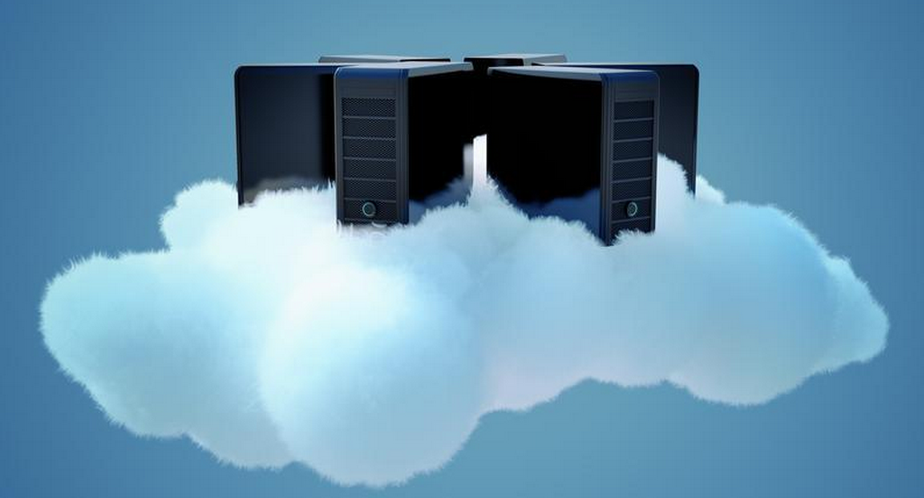
Introduction to Cloud Computing
[thoughtsoncloud.com]
Notes:
Expand notes tab!
=================================================

Slide 2
Outline
What is Cloud Computing?
Characteristics of the Cloud Computing model
Evolution of Cloud Computing
Cloud Computing Architecture
Cloud Services: IaaS, PaaS, SaaS
Pros and Cons
Public Clouds and related resources
Notes:
May want to show video: https://www.youtube.com/watch?v=ae_DKNwK_ms

Slide 3
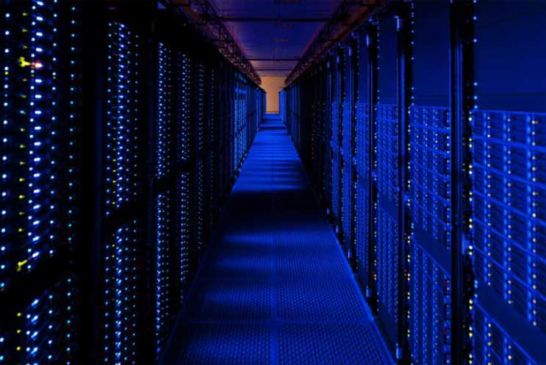
IT Infrastructure
In the past
Today
[pinterest]
[James Hamilton, Amazon Web Services]
Notes:
In the past if I owned a company and wanted to create a new web service I would have to buy a bunch of hardware, and have someone wire it all together, and connect it to a good Internet connect, power, power backup systems, cooling systems, etc. Oh and by the way, it would have to be sufficient for the peak anticipated usage.
Today, I could instead host my service “in the cloud”, utilizing resources in a data center, and paying for network and compute resources just like I would a commodity like electricty.
https://www.pinterest.com/pin/161355599124687923/

Slide 4
What is Cloud Computing?
NIST Definition
“A model for enabling ubiquitous, convenient, on-demand network access to a shared pool of configurable computing resources that can be rapidly provisioned and released with minimal management effort or service provider interaction.”

Slide 5
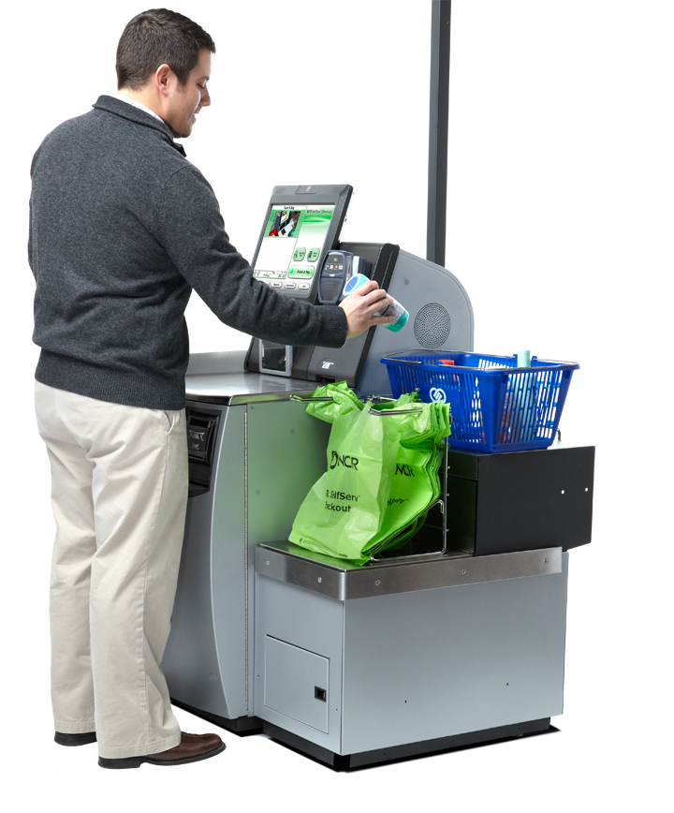
On-Demand Self-Service
On-demand – when the consumer wants it.
Self-service - Consumer performs all the actions to acquire the service.
Automation - Requests are automatically processed, without human intervention on the provider’s side.
[ncr.com]
Notes:
Provider must plan well in advance to ensure resources are available when needed/requested.
Can’t assume consumer has specialized knowledge. Good UI.
Provider needs policies because no humans will look at each new request.
https://remonsinnema.com/cloud-2/cloud-computing/on-demand-self-service/
http://www.ncr.com/retail/petroleum-convenience/customer-engagement/self-service-checkout-ssco

Slide 6
Broad Network Access
Consumers are physically separated from the computing capabilities
Those capabilities must be available over a network, and
Accessed through standard mechanisms and devices.
[platformpurple.com]
Notes:
http://platformpurple.com/wp-content/uploads/2012/03/earth-network300.jpg

Slide 7
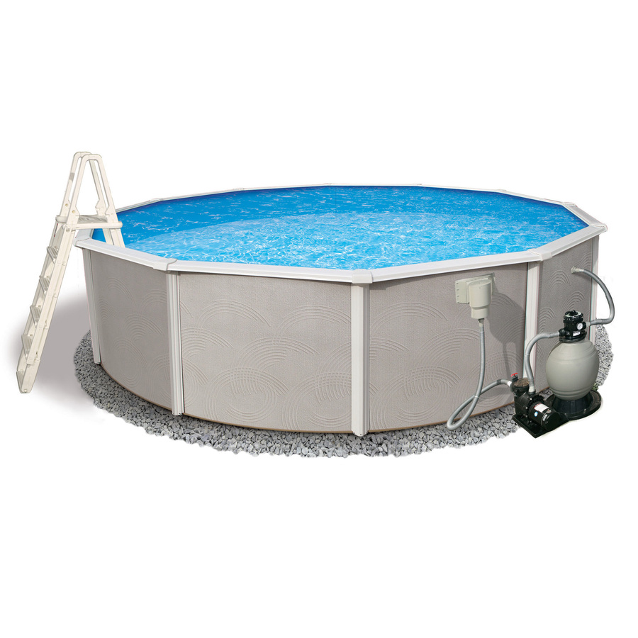
Resource Pooling
Resources are shared
Multi-tenancy – different physical and virtual resources can be assigned and re-assigned according to demand
Generally no knowledge of or control over location
[lowes.com]

Slide 8
Rapid Elasticity
Elasticity – the new scalability
Capabilities can be provisioned or released to rapidly scale with demand.
To the consumer the capabilities often appear to be essentially limitless.
Can be added in any quantity at any time.
[containerstore.com]
Notes:
Used to scale (Horizonatlly) by adding servers or (vertically) by adding extra memory, etc.
Elasticity - More agile.
Demand monitoring
http://www.thoughtsoncloud.com/2012/09/rapid-elasticity-and-the-cloud/
http://www.containerstore.com/s/office/office-accessories/rubber-band-ball/12d?productId=11002714

Slide 9
Measured Service
Resource use is automatically controlled and optimized by leveraging a metering capability.
Typically on a pay-per-use basis
Usage can be monitored controlled and reported.
[http://searchsoa.techtarget.com/]
Notes:
http://searchsoa.techtarget.com/photostory/2240184886/Ten-significant-factors-in-deciding-to-deploy-a-SOA-system/7/Measuring-the-complexity-of-new-services

Slide 10
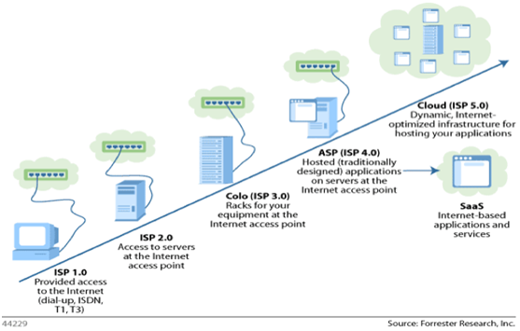
History
Notes:
Colocation.
Active Server Pages

Slide 11
Evolution of Cloud Computing

Slide 12
Evolution of Cloud Services
Notes:
Salesforce customer relationship management. - 1999 founded.

Slide 13
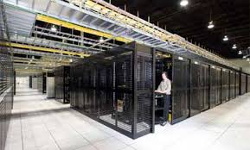
Components of the Cloud
Front-end (regular desktop, thin client, mobile device)
Back-end (servers)
Storage / Datacenters
Delivery Service
(SaaS, PaaS, IaaS)

Slide 14
Service Models (SaaS)
SaaS – Software as a Service
Network hosted application; consumers purchase the ability to access and use the application; consumer cannot manage or control the underlying cloud infrastructure
Examples
Google Apps
SalesForce CRM

Slide 15
Service Models (PaaS)
PaaS – Platform as a Service
Consumer has the ability to deploy their own applications onto the cloud infrastructure; consumer cannot manage or control the underlying cloud infrastructure
Examples
Google App Engine
IBM Bluemix
Force.com (SalesForce Dev Platform)

Slide 16
Service Models (IaaS)
IaaS – Infrastructure as a Service
Consumers has the ability to provision processing, storage, networks, and other fundamental computing resources; consumer cannot manage or control the underlying cloud infrastructure but can control the operating systems, storage and deployed applications
Examples
Amazon EC2

Slide 17
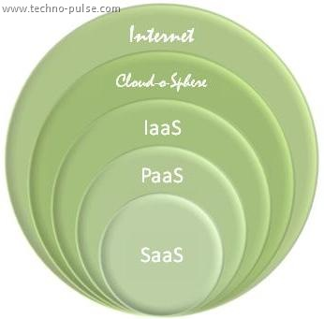
More Service Models
DaaS – Data as a Service
Consumer queries against provider’s database
NaaS – Network as a Service
Provider offers virtualized
networks (e.g. VPNs)

Slide 18
Deployment Models
Public Cloud
Cloud infrastructure is provisioned for open use by the general public.
Private Cloud
Cloud infrastructure is provisioned for exclusive use by a single organization comprising multiple consumers (business units)

Slide 19
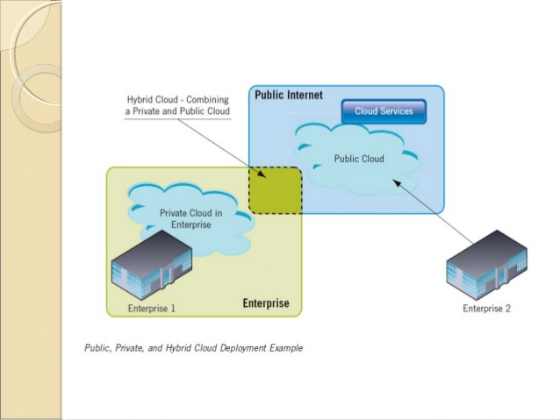
Deployment Models
Notes:
Two or more distinct cloud infrastructures bound together, enabling data and app portability.

Slide 20
Deployment Models
Community Cloud
Cloud infrastructure is provisioned for exclusive use by a specific community of consumers
Hybrid Cloud
Cloud infrastructure is a composition of two or more distinct cloud infrastructures (public, private, or community)

Slide 21
Advantages of Cloud Computing
SaaS – easy consumer adoption
PaaS – good for developers
IaaS – complete control of environment and infrastructure

Slide 22
Disadvantages of Cloud Computing
SaaS – limited functionality, no control or access to underlying technology
PaaS – restricted to whatever is available on the platform and other dependencies
IaaS - expensive

Slide 23
Benefits
Cost-saving
Scalability, Flexibility, reliability
Ongoing maintenance

Slide 24
Challenges
Security and privacy
Lack of standards
Continuously evolving

Slide 25
Conclusion
“Computing is turning into a utility, and the effects of this transition will ultimately change society as completely as the advent of cheap electricity did.”
- The Big Switch by Nicholas Carr

