Slide 1




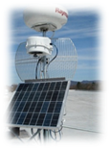
Introduction to
GENI
Ben Newton
University of North Carolina at Chapel Hill bn@cs.unc.edu
www.geni.net

Slide 2
Outline
What is GENI?
How is GENI being used?
Key GENI Concepts
Demo: A simple experiment using GENI

Slide 3
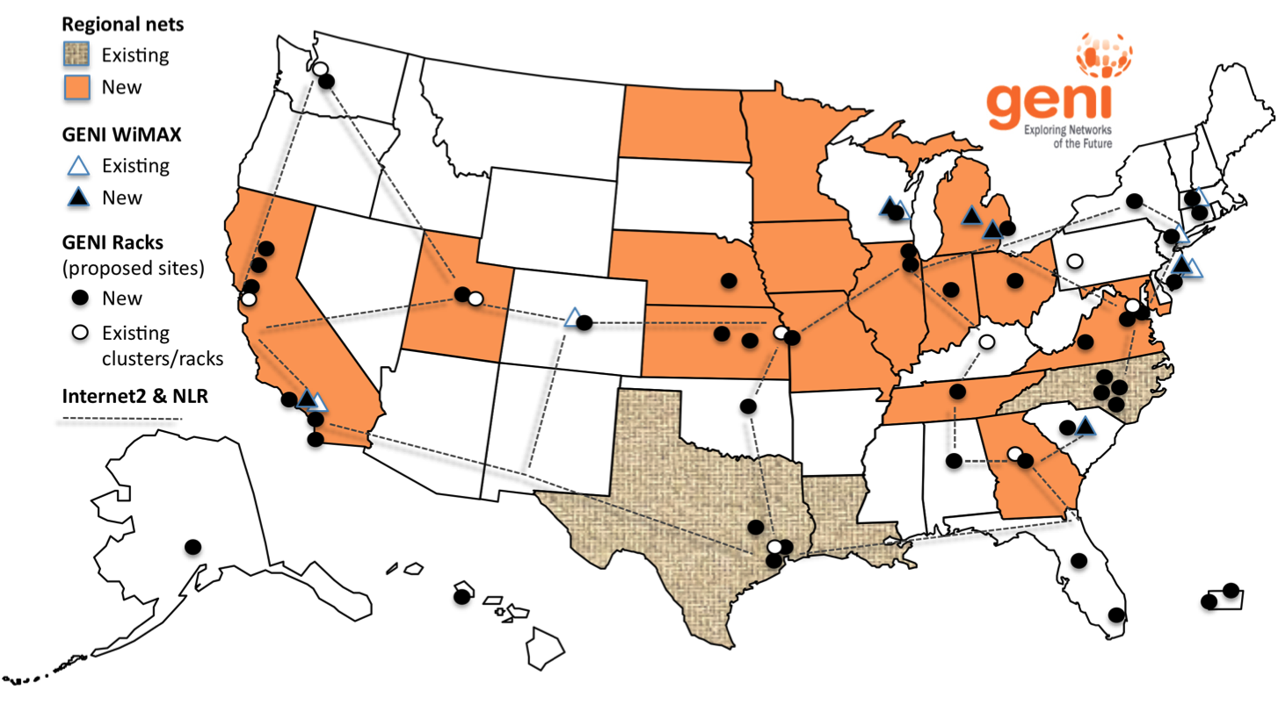
GENI: Infrastructure for Experimentation
GENI provides compute resources that can be connected in experimenter specified Layer 2 topologies.
Notes:
GENI is a nationwide suite of infrastructure for
“at scale” experiments in networking, distributed systems, security, and novel applications.
GENI opens up huge new opportunities
Leading-edge research in next-generation internets
Rapid innovation in novel, large-scale applications
Key GENI concept: slices & deep programmability
Internet: open innovation in application programs
GENI: open innovation deep into the network

Slide 4
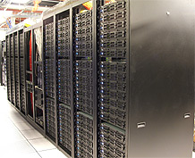
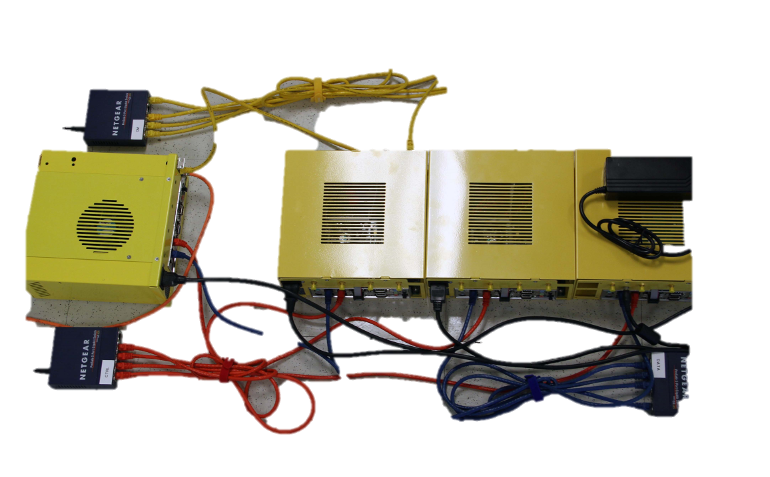
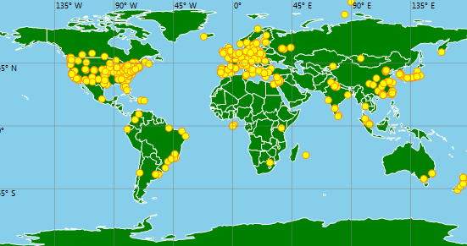
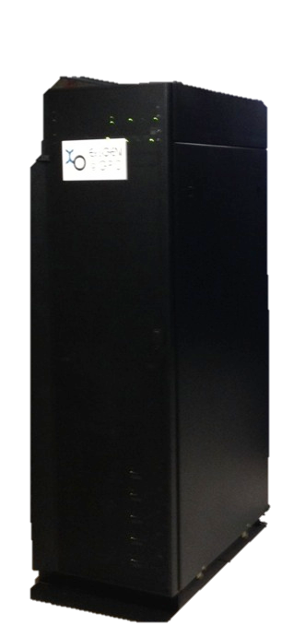
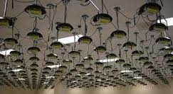
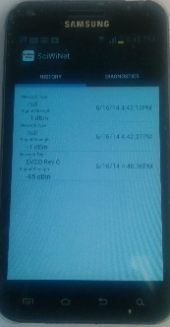
GENI Compute Resources
Emulab
GENI Racks
GENI Wireless compute nodes
Planetlab
ORBIT
Existing Testbeds
Notes:
ORBIT 20x20 indoor 2d grid of programmable radio nodes interconnected into specified topologies. And an outdoor network. Wimax and 802.11

Slide 5
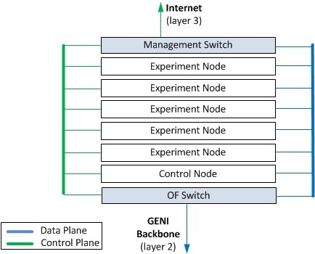
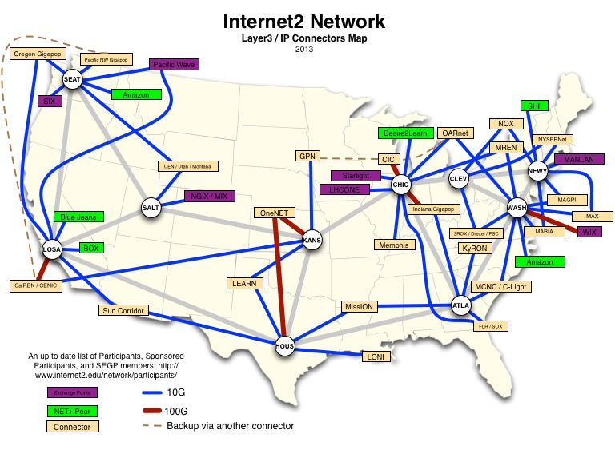
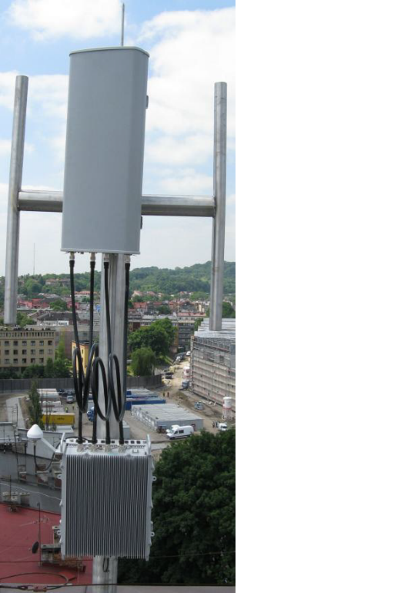
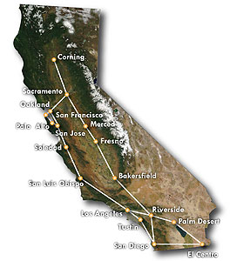
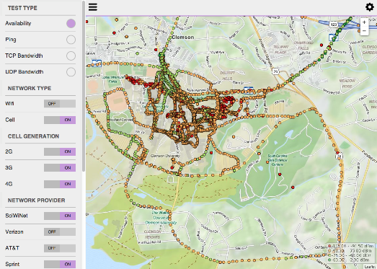
GENI Networking Resources
National Research Backbones
(e.g. Internet2)
Networking within a Rack
Regional Networks
(e.g. CENIC)
4G/3G
GENI network
WiMAX Base Stations

Slide 6













GENI Architecture
ISP
Internet
Metro
Research
Backbones
g
g
Layer 2
Data Plane
GENI-enabled
hardware
Legend
Layer 3
Control Plane
g
Regional Networks
Campus
Flexible network / cloud research infrastructure
Also suitable for physics, genomics, other domain science
Distributed cloud (racks) for content caching, acceleration, etc.

Slide 7
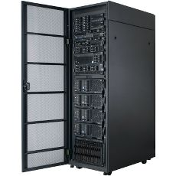
Current GENI buildout
More WiMAX base stations
with Android handsets
GENI-enable 5-6
regional networks
Inject more
OpenFlow switches
into Internet2
Add GENI Racks to 50-80 locations
within campuses, regionals, and
backbone networks
GENI Racks serve as programmable routers, distributed clouds, content distribution nodes, caching or transcoding nodes, etc

Slide 8
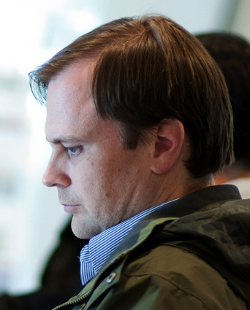


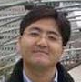
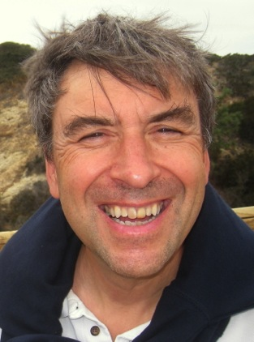

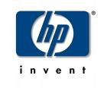
Creating and deploying GENI racks
Ilia Baldine
RENCI
More resources / rack,
fewer racks
Rajesh Narayanan
DELL
KC Wang Clemson
Rick McGeer
HP Labs
Fewer resources / rack,
more racks
Latest addition

Slide 9

GENI WiMAX
On the Air
26 Wimax Base Stations in 13 Sites
Sliced, virtualized
and interconnected
Not On the Air
Researcher-owned,
researcher-operated
4G cellular systems

Slide 10
GENI: Infrastructure for Experimentation
GENI provides compute resources that can be connected in experimenter specified Layer 2 topologies.
Notes:
GENI is a nationwide suite of infrastructure for
“at scale” experiments in networking, distributed systems, security, and novel applications.
GENI opens up huge new opportunities
Leading-edge research in next-generation internets
Rapid innovation in novel, large-scale applications
Key GENI concept: slices & deep programmability
Internet: open innovation in application programs
GENI: open innovation deep into the network

Slide 11

Multiple GENI Experiments run Concurrently
Experiments live in isolated “slices”
Resources can be shared between slices

Slide 12

GENI is “Deeply Programmable”
I install software I want throughout my network slice (into routers, switches, …) or control switches using OpenFlow
OpenFlow is part of the experiment not just the infrastructure
Notes:
Experimenters set up custom:
topologies
protocols
forwarding

Slide 13
Cloud Uses of GENI
GENI Supports:
Any combination of:
  compute/cloud,
  networking/SDN and
  wireless
Explore impact of geographic diversity

Slide 14
Security Uses of GENI
OK to DO
man-in-the middle attacks
Tor networks
DDoS on your own resources (as long as it does not affect other experimenters)
Securing OpenFlow/SDN
Many more…

Slide 15
… but DO NOT
DO NOT use GENI to hack or affect other systems or other experiments
  e.g. Do not hack another tenant on the same server
DO NOT run viruses, worms, or malware which could escape GENI
  Use DETER Lab instead
When in doubt, ask

Slide 16
Outline
What is GENI?
How is GENI being used?
Key GENI Concepts
Demo: A simple experiment using GENI

Slide 17

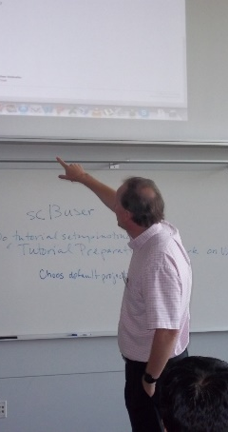
How is GENI being Used?
Research
Future Internet architectures
Software defined networking
Large scale evaluation of smart grid protocols
Education
Networking and Distributed systems classes
Cloud computing classes
WiMAX classes
GENI has over 3400 users!

Slide 18
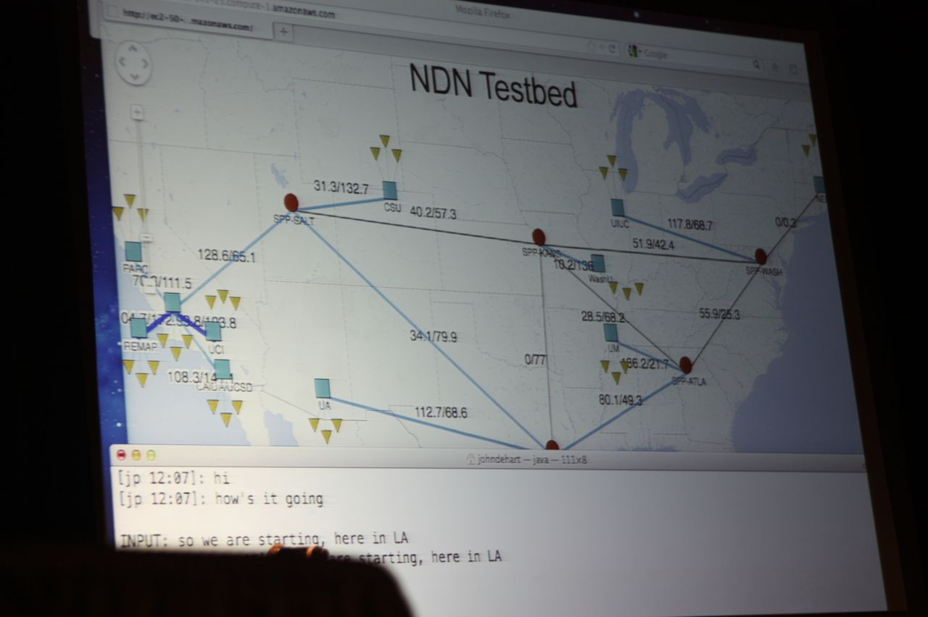
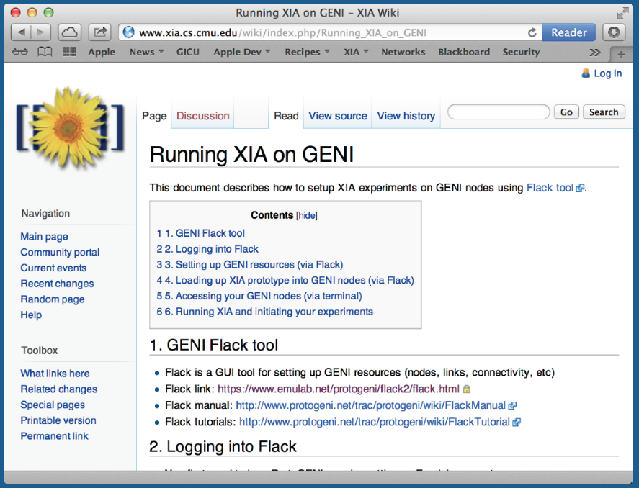
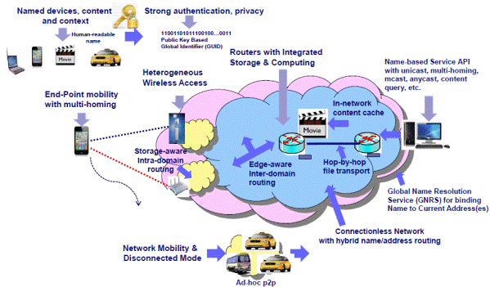
Three FIA Teams have Slices on GENI
NDN (demo at GEC 13)
XIA (demo at GEC15)
MobilityFirst (demo at GEC 12, GEC18, GEC20)
GENI is a unique testbed that can support all of these teams
Tutorials of all three at previous GECs
Notes:
Named Data Networking, Expressive Internet Architecture 5 teams

Slide 19
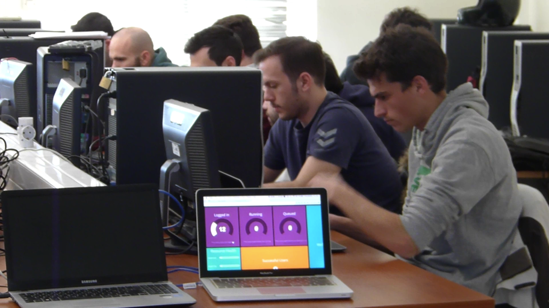
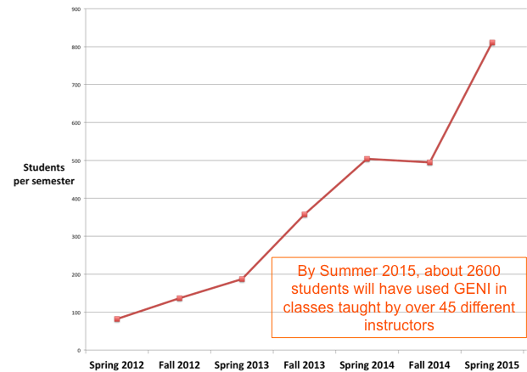
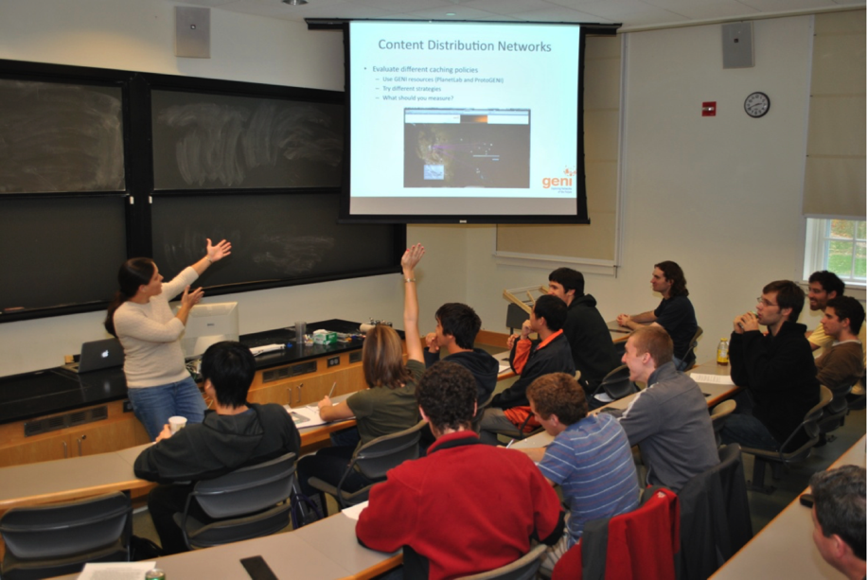
GENI in the Classroom
GENI as a remote, virtual lab for
networking, distributed systems
and cloud computing classes

Slide 20
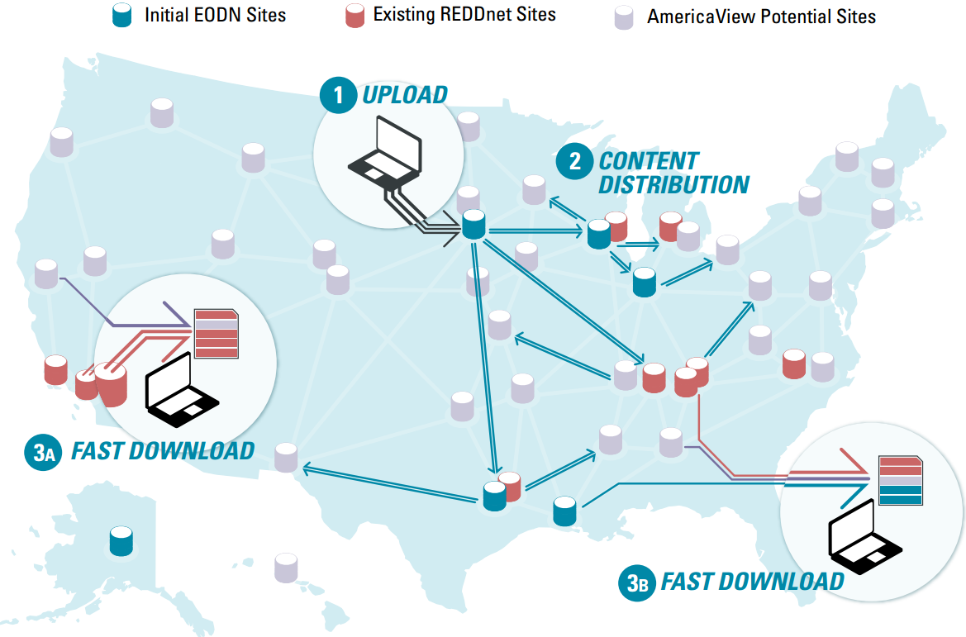
Earth Observation Depot Network (EODN)
Addresses the deployment concerns in enabling open access to remotely sensed data from a wide range of public, private, and commercial sources
Built in part with the NSF-funded Data Logistics Toolkit (DLT)
Deployed on a volunteer basis by AmericaView members in conjunction with existing REDDnet resources
Slide from:
IU: Ezra Kissel, Akshay Dorwat, Jeremy Musser, Prakash Rajagopal, Rohit Khapare, Joseph Cottam, Martin Swany
UW-Madison: Sam Batzli – Director, WisconsinView
SFASU: Paul Blackwell – Exec. Comm., AmericaView
Notes:
20
Open access and fast downloads of valuable earth science info collected from satellites and other sensors.

Slide 21
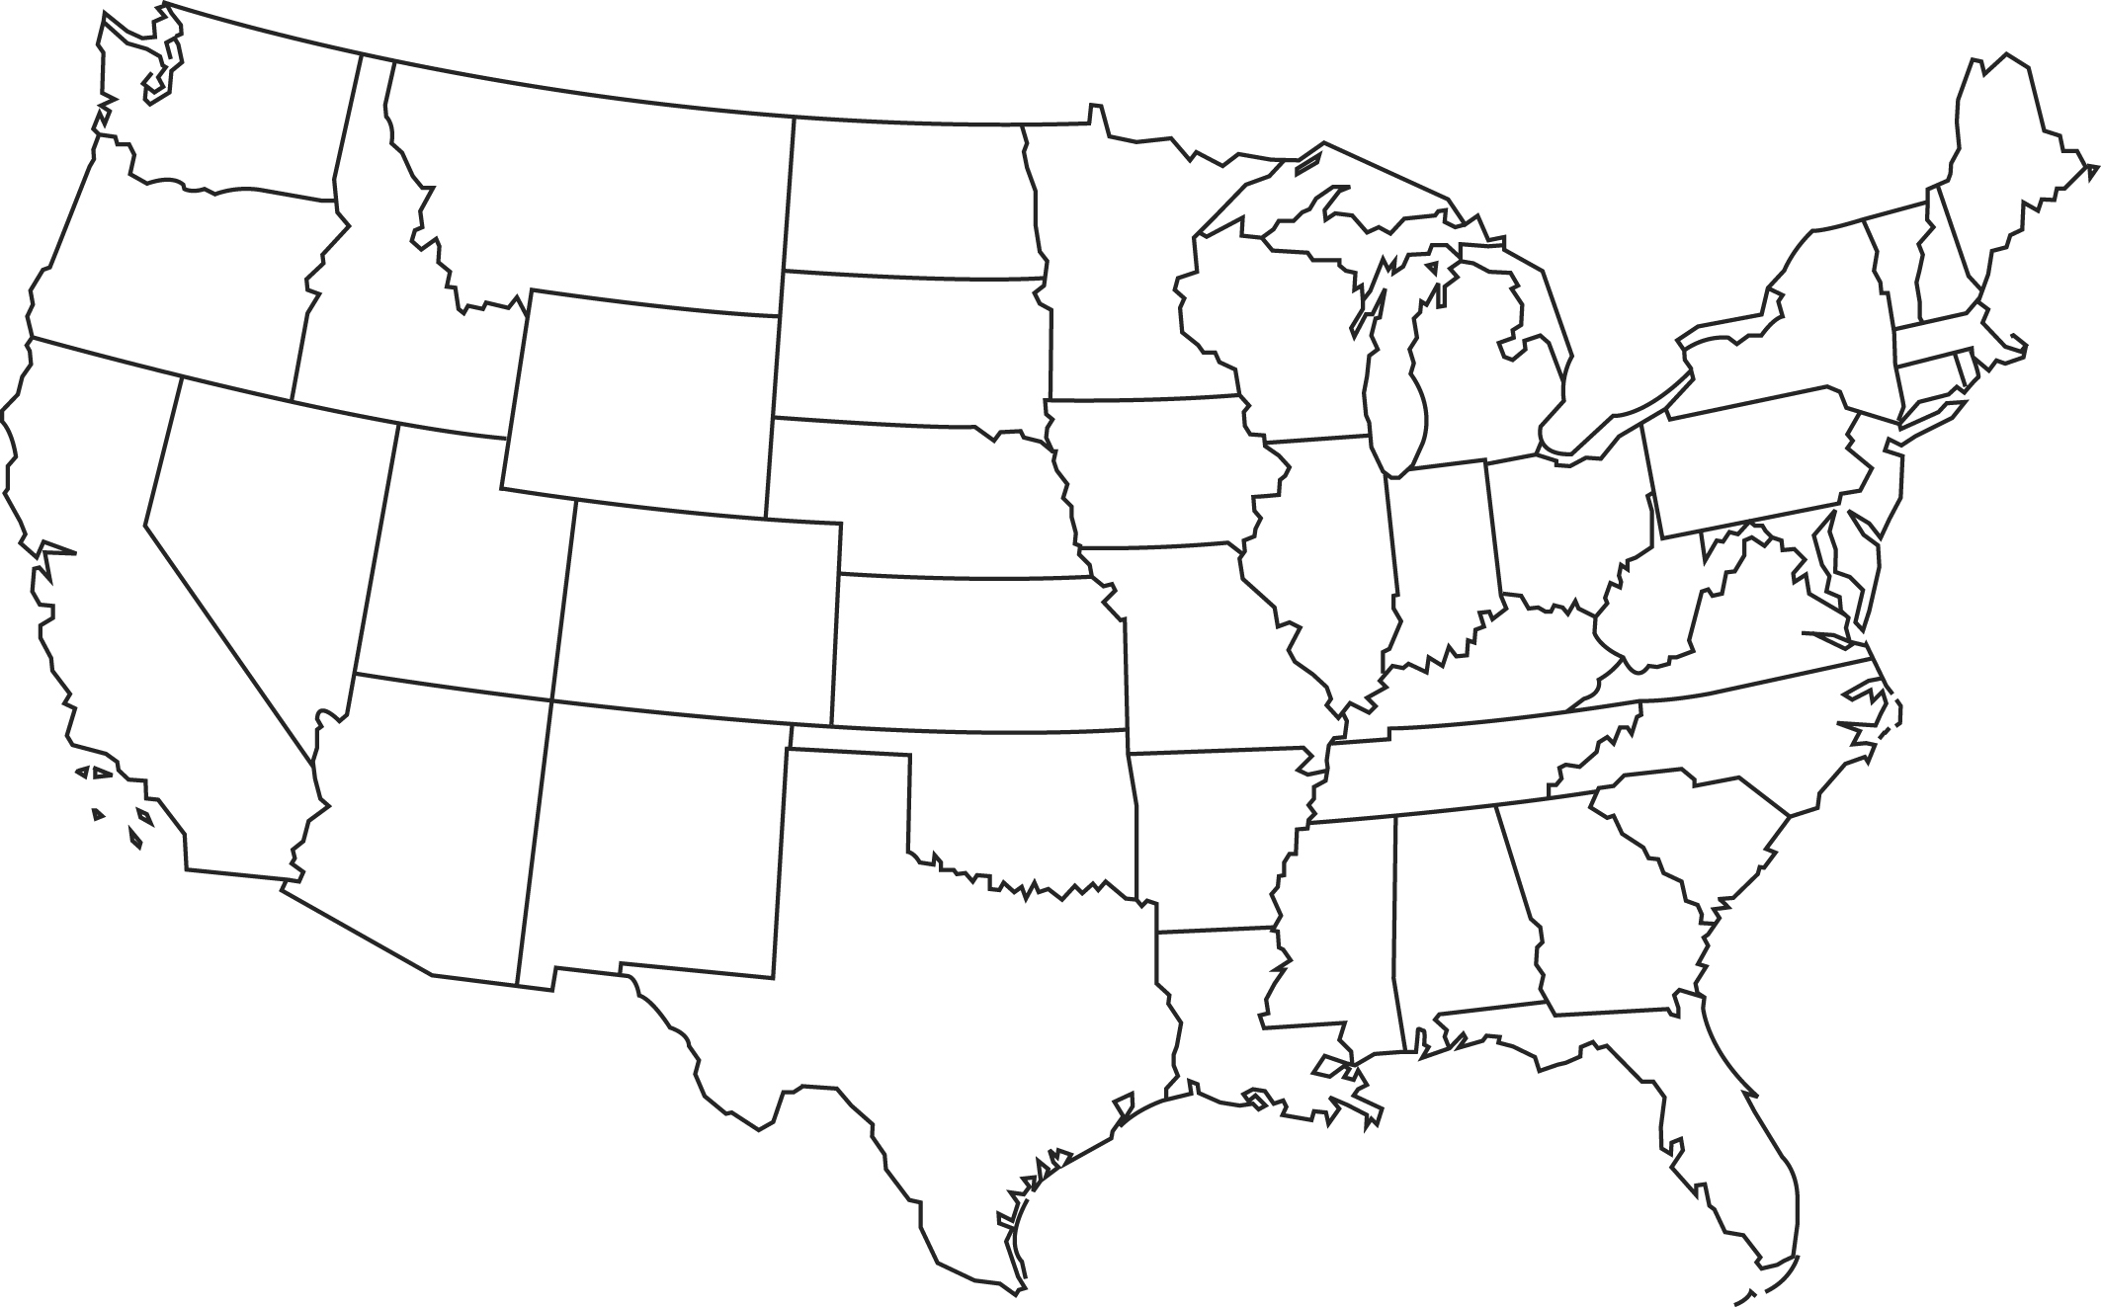

Intelligent Data Movement Service
9 GENI racks
~30 VMs (1-2 cores, 8G – 1TB storage each)
~8 TB of GENI storage exposed
Custom images
Long-lived slices
Inter-domain stitching
Shared vlans
External access to data plane
LAN
LAN
NYSER
NEWY
I2 GW
GPO
LAN
LAN
WASH
I2 GW
UTAH
DDC
MAX
UCD
SALT
I2 GW
LAN
MIZZ
RCI
LAN
KANS
I2 GW
UCLA
GENI rack depots
New EODN depots
Slide from:
IU: Ezra Kissel, Akshay Dorwat, Jeremy Musser, Prakash Rajagopal, Rohit Khapare, Joseph Cottam, Martin Swany
UW-Madison: Sam Batzli – Director, WisconsinView
SFASU: Paul Blackwell – Exec. Comm., AmericaView
I2 Gateway (ION)
TAMU
AL2S
R&E access
ION

Slide 22
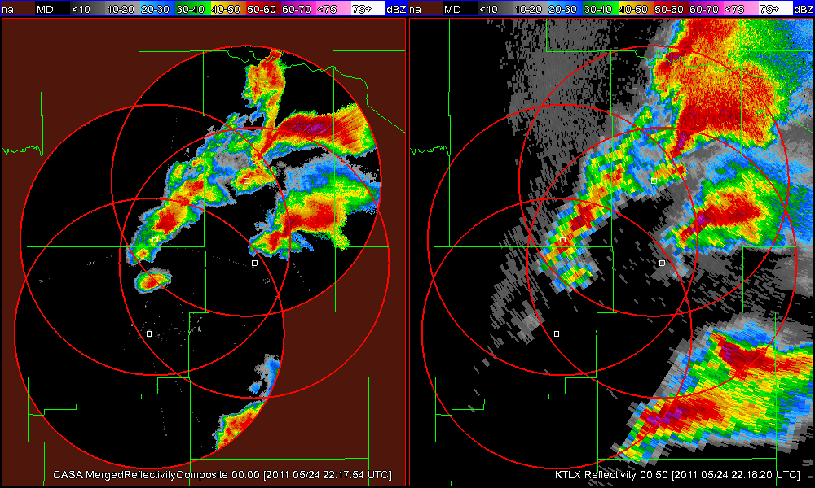
NowCast System
Slide by Mike Zink, UMass Amherst
Short-term weather prediction (1-15 mins)
Forecasts as we
know them:
Data from many
sensors: Radar,
satellite, balloons,
Usually for large
regions
Takes super
computers to calculate

Slide 23
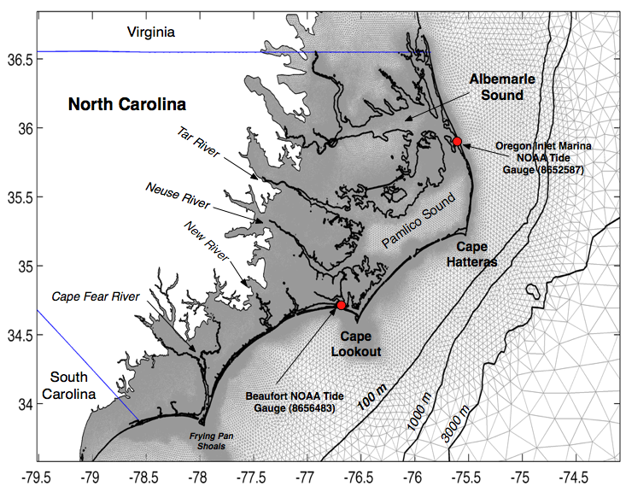
Urgent Computing
ADCIRC
Brian Blanton (RENCI)
  Storm surge and tide model
  Finite element model
  MPI tightly coupled
  Approved by FEMA for computing storm surge flood hazard simulations
  Used for Digital Flood Insurance Rate Maps (DFIRMs)
  Scales to 10000+ MPI processes
Slide by Paul Ruth

Slide 24
Outline
What is GENI?
How is GENI being used?
Key GENI Concepts
Demo: A simple experiment using GENI

