Slide 1


GENI Terminology
Sponsored by the National Science Foundation

Slide 2
project
slice
experimenter
resource
aggregate
Cloud Security Curriculum Workshop – July 13, 2016
www.geni.net

Slide 3
An experimenter
is a researcher who uses GENI resources
Different types of experimenters have different roles and permissions:
Advisor vs Grad Student
Teacher vs TA vs Student
Experimenter
Cloud Security Curriculum Workshop – July 13, 2016
www.geni.net
Notes:
An experimenter is a researcher who uses GENI resources.
Different experimenters will have different roles in GENI and therefore different permissions.
For example, …..

Slide 4

Creating an Account
GENI Portal is at:
  https://portal.geni.net
Instructions for creating an account are:
http://groups.geni.net/geni/wiki/SignMeUp
Cloud Security Curriculum Workshop – July 13, 2016
www.geni.net
Notes:
Anyone with an account at a supported identity provider can log in to the GENI portal but they will have no privileges. You must be a member of a project to do anything interesting.

Slide 5


GENI User Authentication
The GENI Portal leverages InCommon for single sign-on authentication
Experimenters from 304 educational and research institutions have InCommon accounts
For many experimenters:
  no new passwords
  familiar login screens
GENI Project Office runs a federated IdP to provide accounts for non-federated organizations.
Cloud Security Curriculum Workshop – July 13, 2016
www.geni.net
Notes:
The GENI Portal trusts identity providers who are members of the InCommon federation.
Students, faculty and staff will have an account provided by their school (for example, the University of Utah) which they use to access campus resources.
They can then use that account to login to GENI as long as their school is a member of InCommon (with some caveats). **This is exactly like using your Facebook or Google account to access other websites.**
For those experimenters, there are no new passwords. For all others, we are happy to make you an account on the GPO’s identity provider.
Anyone with an account at a supported identity provider (usually your school or employer) can log in, but they will have no privileges
If you don’t have such an account, we will make you an account at the GPO Identity Provider
You must be a member of a project to do anything interesting

Slide 6
Projects organize research in GENI
Project
Slice
Lead
Members
  Projects contain both people and their experiments
A project is led by a single responsible individual:
the project lead
Cloud Security Curriculum Workshop – July 13, 2016
www.geni.net
Notes:
Experimenters can perform experiments in the context of a project.
Projects contain both people and their experiments. (Experiments are represented by slices, a term we will define in a few minutes.)
A project must have a single individual who is willing to take responsibility for what happens within the project. This person is called the project lead.

Slide 7


A slice is a container of resources used in an experiment.
A slice can contain resources from one or more aggregates
A slice is in a single project
A slice has an expiration
Slice names are public, reusable and unique (within a project)
Cloud Security Curriculum Workshop – July 13, 2016
www.geni.net
Notes:
A slice is a container for the resources you are using in your experiment.
A slice usually contains resources from multiple aggregates. A slice belongs to a single project and has an expiration. And slice names are unique within a project.

Slide 8
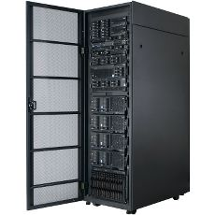
A resource
is a piece of infrastructure
A resource can be real or virtual.
Resource specifications (aka. RSpecs) are used to describe and request resources.
Examples:
Compute: computer vs virtual machine (VM)
Wireline Network: VLAN or OpenFlow
Wireless: WiMAX
Cloud Security Curriculum Workshop – July 13, 2016
www.geni.net
Notes:
A resource is something you can reserve -- like a computer or network. Resources can be real or virtualized.
The description of the resources you want to reserve are called a resource specification (abbreviated RSpec).

Slide 9
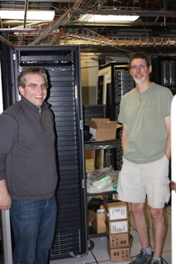
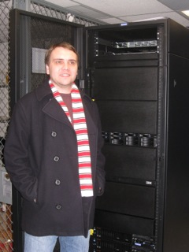
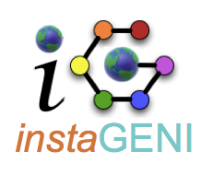

An aggregate manages a set of reservable resources
Aggregates include:
  GENI racks
  OpenFlow
  WiMAX
InstaGENI Rack
ExoGENI Rack
Cloud Security Curriculum Workshop – July 13, 2016
www.geni.net
Notes:
An aggregate manages a set of available resources.
The GENI racks contains aggregates advertising compute and network resources.

Slide 10

project
Lead:
Member:
Experimenter
(aka Professor)
Experimenter
(aka Student)
slice
aggregate
resource
resource
Layer 2
Cloud Security Curriculum Workshop – July 13, 2016
www.geni.net
Notes:
10

Slide 11
Demo
Sponsored by the National Science Foundation

