Slide 1
Introduction to OpenFlow
Ben Newton
University of North Carolina at Chapel Hill

Slide 2
“The current Internet is at an impasse because new architecture cannot be deployed or even adequately evaluated” [PST04]
[PST04]: Overcoming the Internet Impasse through Virtualization, Larry Peterson, Scott Shenker, Jonothan Turner Hotnets 2004
Modified slide from: http://cenic2012.cenic.org/program/slides/CenicOpenFlow-3-9-12-submit.pdf

Slide 3
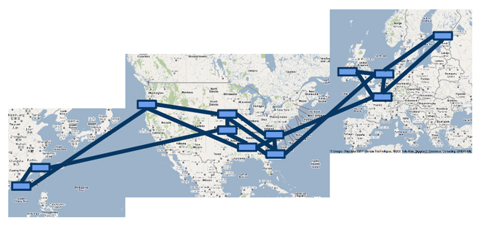
OpenFlow…
Enables innovation in networking
Changes the practice of networking
Google’s SDN WAN

Slide 4
OpenFlow basics
How OpenFlow works … (1.0)
Network Function Virtualization
OpenFlow basics

Slide 5
OpenFlow’s basic idea

Slide 6
OpenFlow’s basic idea

Slide 7
OpenFlow is an API
Control how packets are forwarded
Implementable on COTS hardware
Makes deployed networks programmable
not just configurable
Makes innovation easier
Modified slide from : http://www.deutsche-telekom-laboratories.de/~robert/GENI-Experimenters-Workshop.ppt

Slide 8
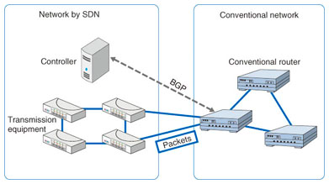
Deployment Stories
Google global private WAN [1]
Connects dozens of datacenters worldwide with a long-term average of 70% utilization over all links
Stanford Campus deployment
Part of Stanford campus migrated to OpenFlow
Microsoft Azure DataCenter [2]
Internet 2 - AL2S
Can build Layer 2 circuits between any Internet 2 end-points
NTT’s BGP Free Edge
https://www.ntt-review.jp/archive/ntttechnical.php?contents=ntr201310fa3.html
[1] B4: Experience with a Globally-Deployed Software Defined WAN, SIGCOMM’13, Jain et al
[2] Keynote ONS June 2015

Slide 9
GENI and OpenFlow deployment
Key GENI concept: slices & deep programmability
Internet: open innovation in application programs
GENI: open innovation deep into the network
Good old Internet
Slice 0
Slice 1
Slice 1
OpenFlow switches one of the ways GENI is providing deep programmability
Slice 2
Slice 3
Slice 4

Slide 10
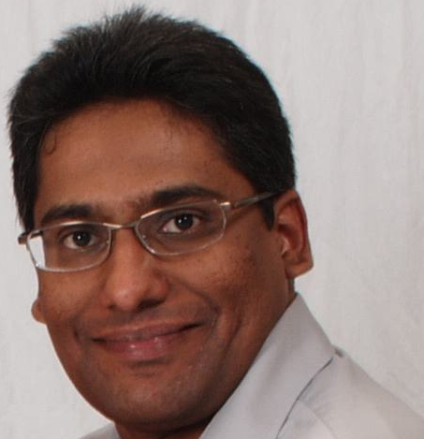
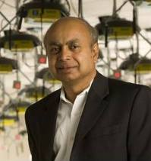
GENI OpenFlow Experiments
VDC: real-time load-balancing functionality deep into the network to improve QoE
Prasad Calyam, Missouri
MobilityFirst: A new architecture for the Internet designed for emerging mobile/wireless service requirements at scale
Dipankar (Ray) Raychaudhuri, Rutgers, leads MobilityFirst
NowCast SDX: Improve in-time weather forecasting using Software Defined eXchanges
Mike Zink
Umass Amherst
Notes:
Quality of Experience

Slide 11
OpenFlow basics
Network Function Virtualization
How OpenFlow works … (1.0)

Slide 12
OpenFlow controllers
Open source controller frameworks
NoX – C++
PoX - Python
OpenDaylight - Java
FloodLight - Java
Trema – C / Ruby
Maestro - Java
Ryu - Python
Production controllers
Mostly customized solutions based on Open Source frameworks
ProgrammableFlow - NEC
Notes:
Ree yooh – means flow in Japanese

Slide 13
OpenFlow
Any Host
The controller is responsible for populating forwarding table of the switch
In a table miss the switch asks the controller
OpenFlow Controller
OpenFlow Protocol (SSL/TCP)
Switch
Control Path
OpenFlow
Data Path (Hardware)
Modified slide from : http://www.deutsche-telekom-laboratories.de/~robert/GENI-Experimenters-Workshop.ppt

Slide 14
OpenFlow in action
Any Host
Host1 sends a packet
If there are no rules about handling this packet
Forward packet to the controller
Controller installs a flow
Subsequent packets do not go through the controller
OpenFlow Controller
OpenFlow Protocol (SSL/TCP)
Switch
Control Path
OpenFlow
Data Path (Hardware)
host1
host2
Modified slide from : http://www.deutsche-telekom-laboratories.de/~robert/GENI-Experimenters-Workshop.ppt

Slide 15
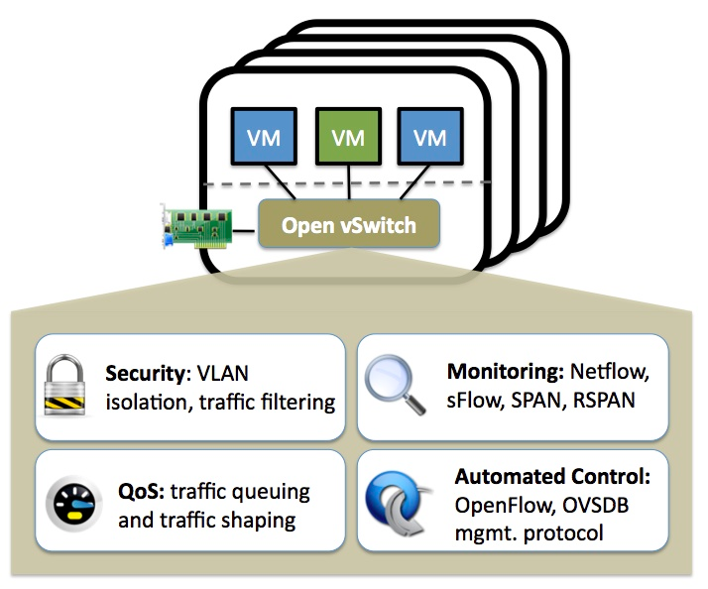
OpenFlow Experiments
Debugging OpenFlow experiments is hard:
Network configuration debugging requires coordination
Many networking elements in play
No console access to the switch
Before deploying your OpenFlow experiment test your controller.
http://mininet.github.com/
http://openvswitch.org/

Slide 16
OpenFlow basics
How OpenFlow works … (1.0)
Network Function Virtualization

Slide 17
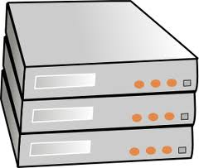
Network Devices
DHCP
access point
router
DNS
proxy
VPN
gateway
firewall
NAT
switch
software
Any network device can be OpenFlow enabled

Slide 18
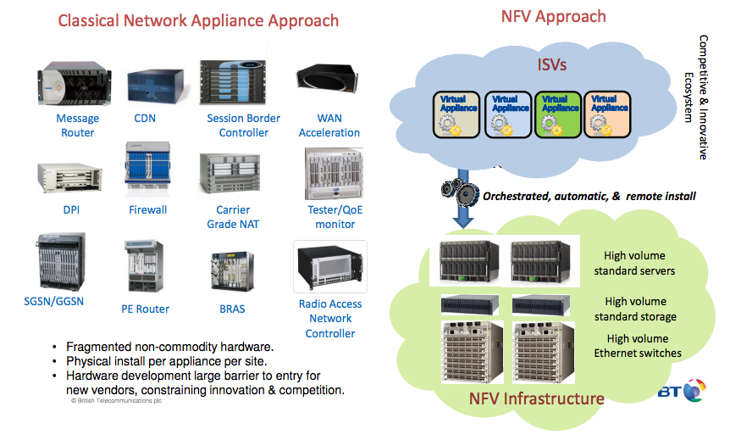
SDN and NFV
Slide from: http://docbox.etsi.org/Workshop/2013/201304_FNTWORKSHOP/S07_NFV/BT_REID.pdf

Slide 19
Questions?

Slide 20
Multi-Version OF Handshake
Handshake
Message-exchanging process to establish an OpenFlow channel between a controller and a switch
Need to negotiate common OpenFlow version
Algorithm
Switch says “Hello version_X” with OF version X
Controller says “Hello version_Y” with OF version Y
Switch and controller each pick lower version of X and Y
(theirs < mine) ? theirs : mine; e.g. (X < Y) ? X : Y;
Caveat…
Algorithm requires support for each OF version up to and including the “Hello” version advertised
Not the case in implementation/practice
Fix for (controller >= OF1.3) && (switch >= OF1.3)
Hello advertises highest version + version bitmap for negotiation
slide provided by Ryan Izard

Slide 21
OpenFlow Auxiliary Connections
Multiple control connections per switch
Parallelize some operations
Negotiated on a per-switch basis
Aux ID 0 = main; Aux ID > 0 = other
Controller chooses which connection to use
Main
Aux 1
Aux 2
…etc.
ID=0 (main)
ID=1
DPID=11:22:33:44:55:66:77:88
ID=2
slide provided by Ryan Izard

Slide 22
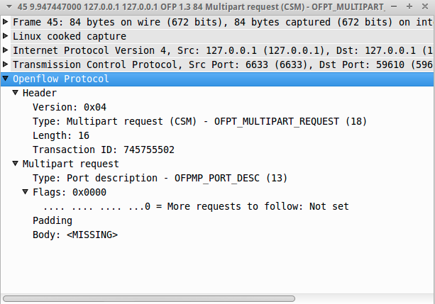
OpenFlow Multipart Messages
Steady-state controller-to-switch “queries”
Efficiently process large requests
Flow stats, port stats, group stats, meter stats, table features…
Request and reply pairs with same XID
OFPMPF_REQ_MORE flag for more messages
slide provided by Ryan Izard

