Slide 1
Distributed Computing using CloudLab
Linh B. Ngo
Clemson University

Slide 2
Introduction
Distributed and Cluster Computing (CPSC 3620)
Offered twice per academic year
Average class size: 40-45 students
Required junior-level class (typically taken at senior year)
Contents:
Infrastructure/System-oriented
Performance/Efficiency
High Performance Computing
MPI
Big Data Computing
Hadoop MapReduce
Apache Spark
HPCCSystems

Slide 3
Computing Resources
Palmetto Supercomputer
2000+ nodes, open to all faculty/students
No administrative access
Cannot share nodes among students to support group assignment
Preemption from node owners
CloudLab
Limited resources for large-scale study
Administrative access
Ease of collaboration
No preemption

Slide 4
Computing Resources
Combine both local computing resources and CloudLab
Learning outcomes through CloudLab
Administrative skills for distributed systems
In-depth understanding of distributed systems
Learning outcomes through Palmetto
Basic understanding of parallel application development
Impacts of scaling and efficiency on larger systems

Slide 5
Tutorial
Set up environments for distributed computing on CloudLab
MPI
Two-node cluster
OpenMPI
Hadoop
Three-node cluster
Hortonwork Distribution

Slide 6
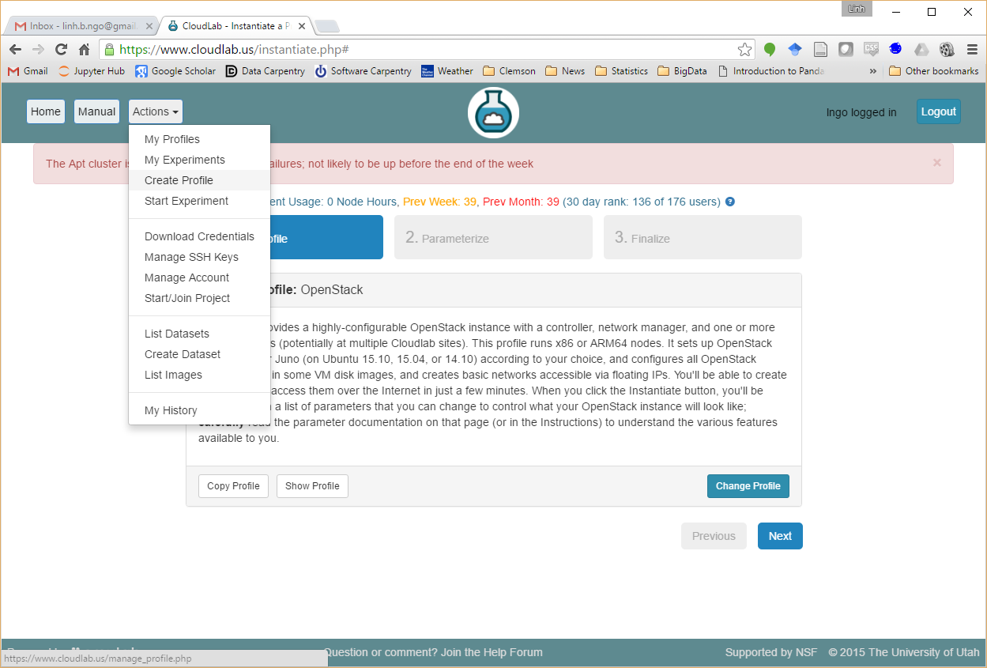

Slide 7
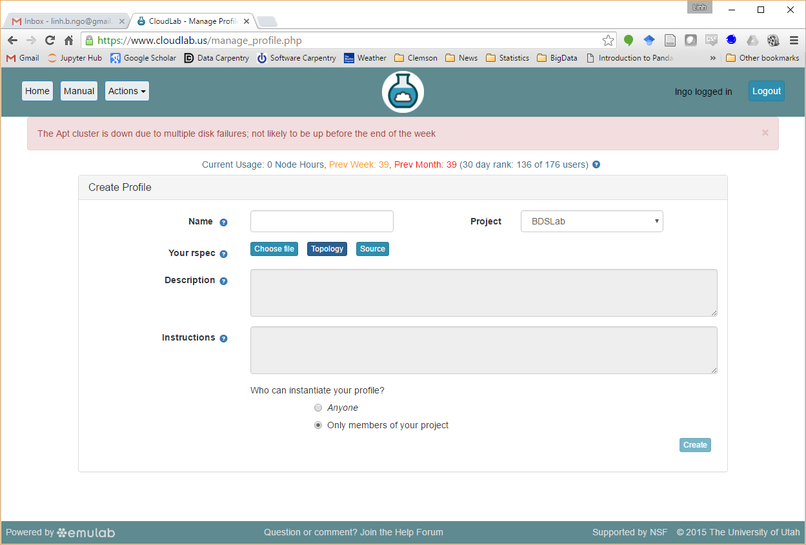

Slide 8
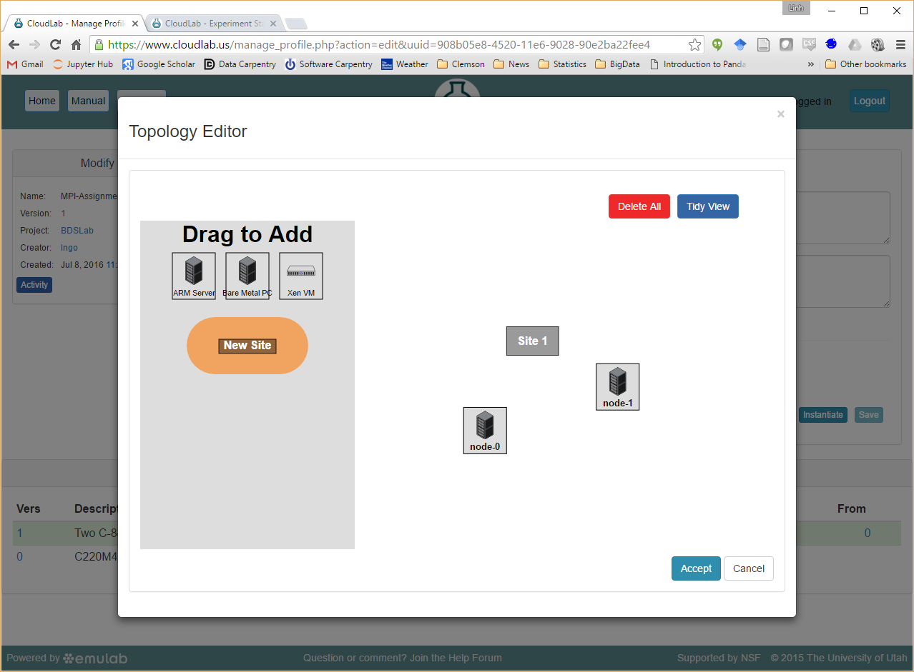

Slide 9
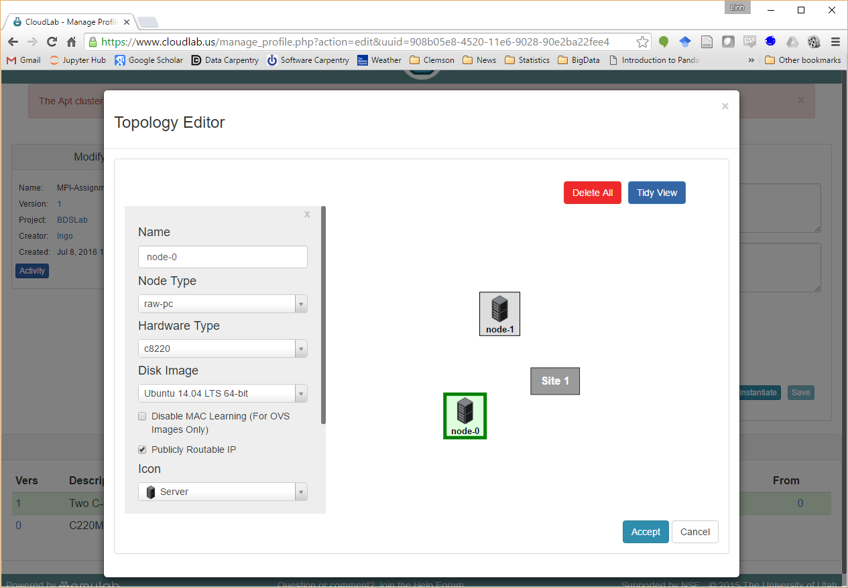
Both nodes should have the same configuration, no network connection is needed (due to public IP)

Slide 10
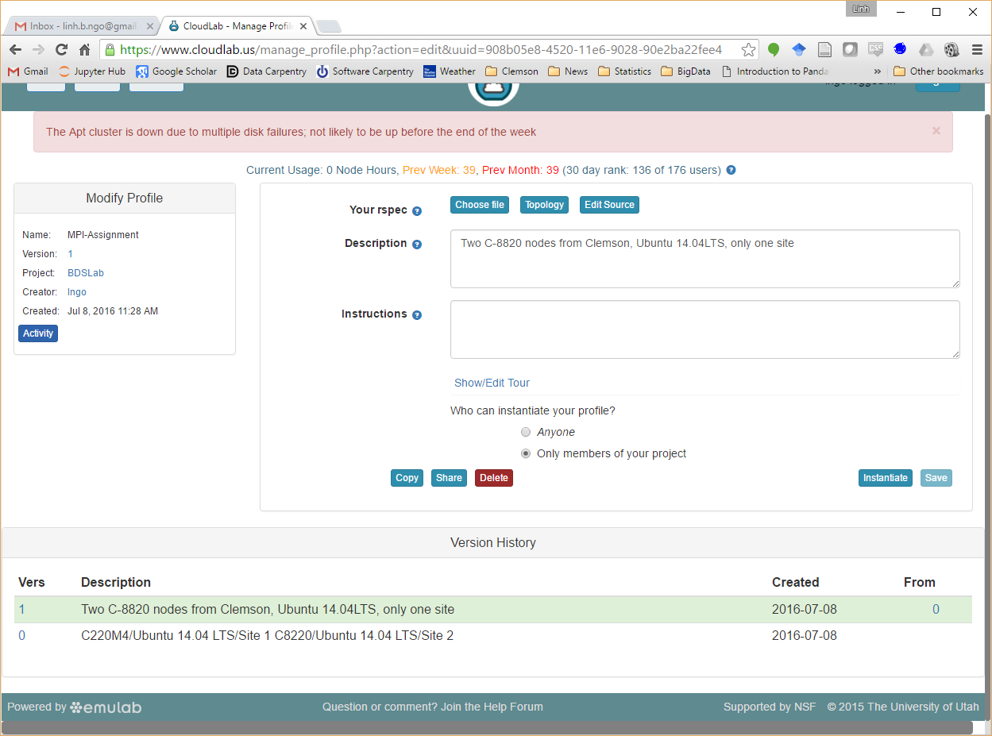
You can save multiple versions of your topology
Instantiate the version that you want to launch
The launching procedure will be similar to the OpenStack tutorial

Slide 11
MPI on CloudLab
On each node:
sudo apt-get update
sudo apt-get install libibnetdisc-dev
sudo nano /etc/environment
PATH="/usr/local/sbin:/usr/local/bin:/usr/sbin:/usr/bin:/sbin:/bin:/usr/games:/usr/local/games:/home/mpiuser/.openmpi/bin"
LD_LIBRARY_PATH="/lib:/usr/lib:/usr/local/lib:/home/mpiuser/.openmpi/lib/“
sudo adduser mpiuser

Slide 12
MPI on CloudLab
sudo adduser mpiuser
ssh mpiuser@localhost
wget https://www.open-mpi.org/software/ompi/v1.8/downloads/openmpi-1.8.1.tar.gz
tar xzf openmpi-1.8.1.tar.gz
cd openmpi-1.8.1
./configure --prefix=“/home/mpiuser/.openmpi”
make
make install

Slide 13
MPI on CloudLab
ssh-keygen –t rsa
cd .ssh
cp id_rsa.pub authorized_keys
ssh-copy-id -i id_rsa.pub <hostname of the other node>
nano nodelist
<hostname of first node>
<hostname of second node>
…

Slide 14
Example program
#include <stdio.h>
#include <unistd.h>
#include <sys/utsname.h>
#include <mpi.h>
int main(int argc, char *argv[]){
int rank, size;
MPI_Status status;
MPI_Init(&argc,&argv);
MPI_Comm_size(MPI_COMM_WORLD,&size);
MPI_Comm_rank(MPI_COMM_WORLD,&rank);
struct utsname uts;
uname(&uts);
printf("%d at %s\n",rank,uts.nodename);
MPI_Finalize();
return 0;
}

Slide 15
MPI on CloudLab
mpicc gethostname.c –o gethostname
scp gethostname mpiuser@<the other node>:/home/mpiuser
scp nodelist mpiuser@<the other node>:/home/mpiuser
mpirun –np 2 –machinefile nodelist ./gethostname
mpirun –np 2 –machinefile nodelist --map-by node ./gethostname

Slide 16
Assignment Ideas
Develop a work queue using various allocation strategies:
Normal
Cyclic
Dynamic
Setup MPI cluster with nodes on separate sites, reduce network connection, and evaluate performance on different allocation strategies

Slide 17
Hadoop on CloudLab
Enterprise Hadoop
Hortonworks
http://hortonworks.com/hdp/downloads/

Slide 18
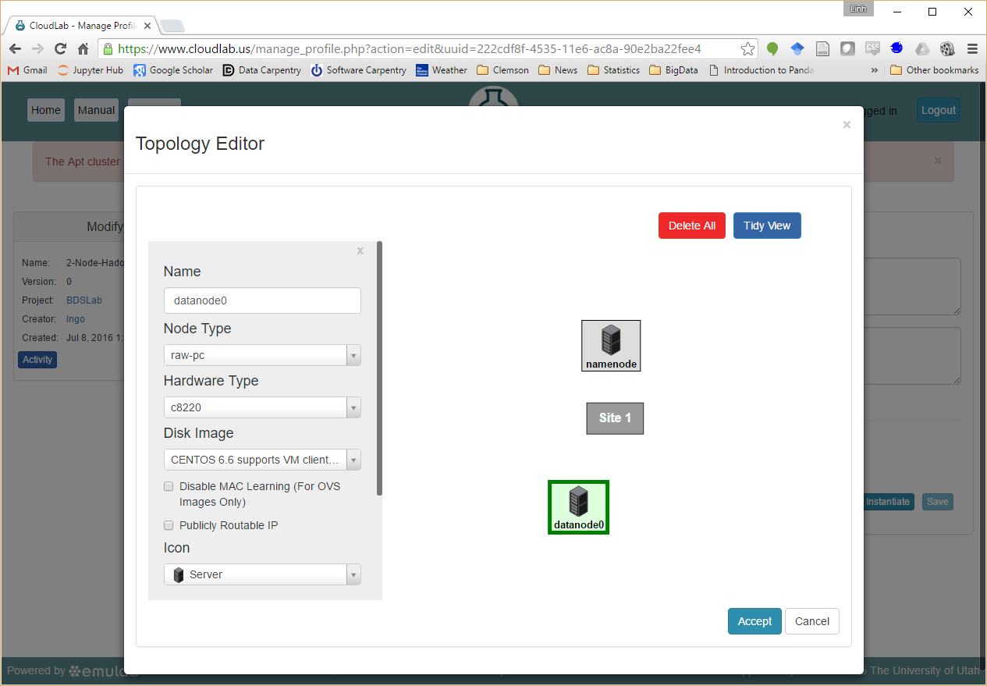
Hadoop on CloudLab
Both nodes should have the same configuration on bare metal PC, no network connection is needed (due to public IP)

Slide 19
On each node
SSH onto the node from Palmetto
Change to root:
sudo su –
Execute the following commands:
chkconfig --list ntpd
chkconfig ntpd on
service ntpd start
chkconfig iptables off
/etc/init.d/iptables stop
setenforce 0

Slide 20
On each node
Setup Ambari download server
wget -nv http://public-repo-1.hortonworks.com/ambari/centos6/2.x/updates/2.1.2/ambari.repo -O /etc/yum.repos.d/ambari.repo
On namenode
yum –y install ambari-server
yum –y install ambari-agent
On datanode
yum –y install ambari-agent

Slide 21
On namenode
Set up ambari server:
ambari-server setup
Select default for all questions
Select 1 for JDK version
When all done, start ambari server
ambari-server start

Slide 22
On each node
Using vim to edit /etc/ambari-agent/conf/ambari-agent.ini
Change:
hostname=<hostname of namenode as shown in list view of CloudLab>
Start Ambari Agent
ambari-agent start

Slide 23
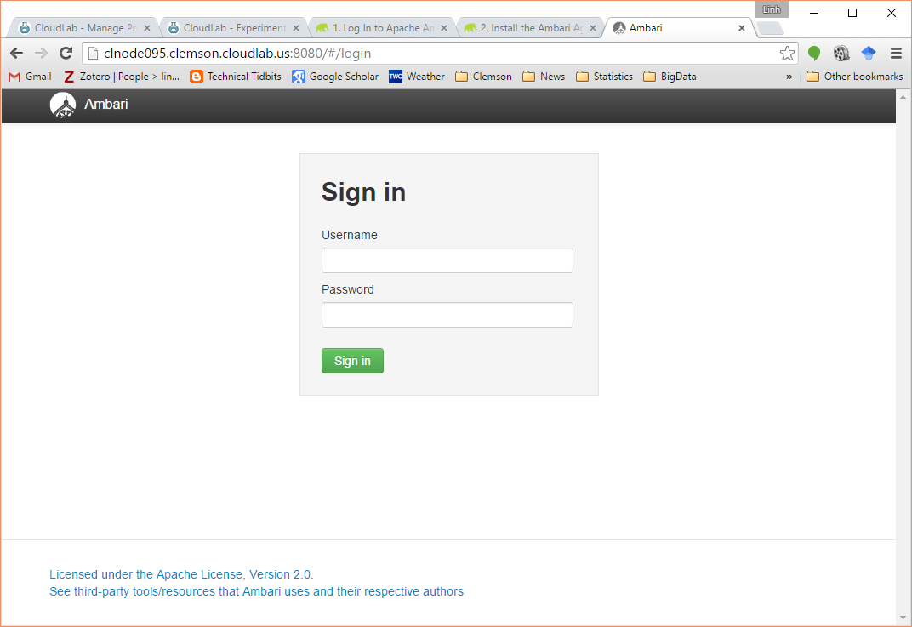
Ambari Server (admin/admin)

Slide 24
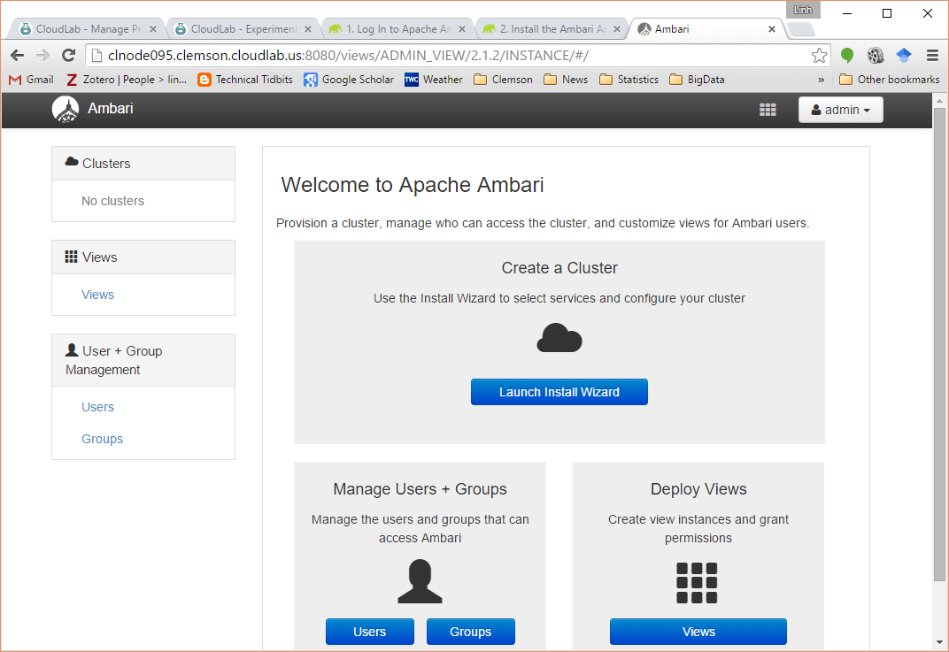
Ambari Server (admin/admin)

Slide 25
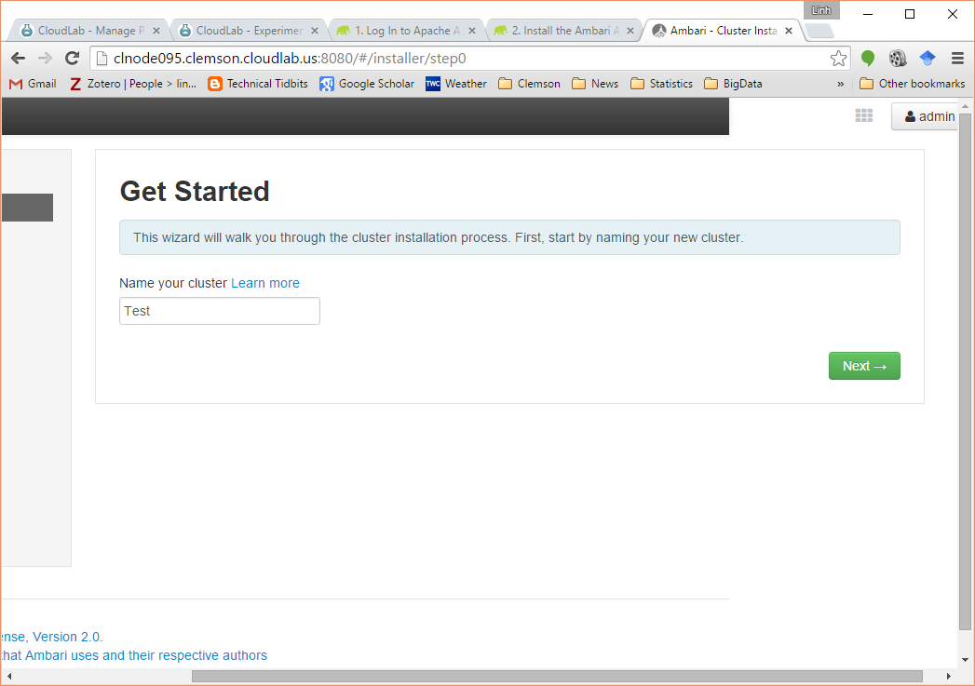
Ambari Server (admin/admin)

Slide 26
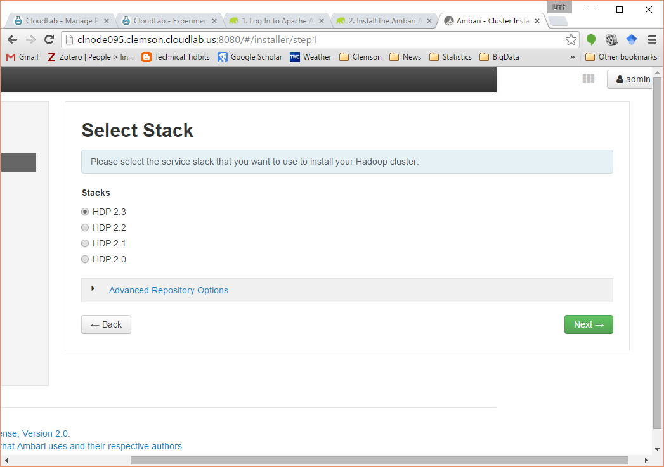
Ambari Server (admin/admin)

Slide 27
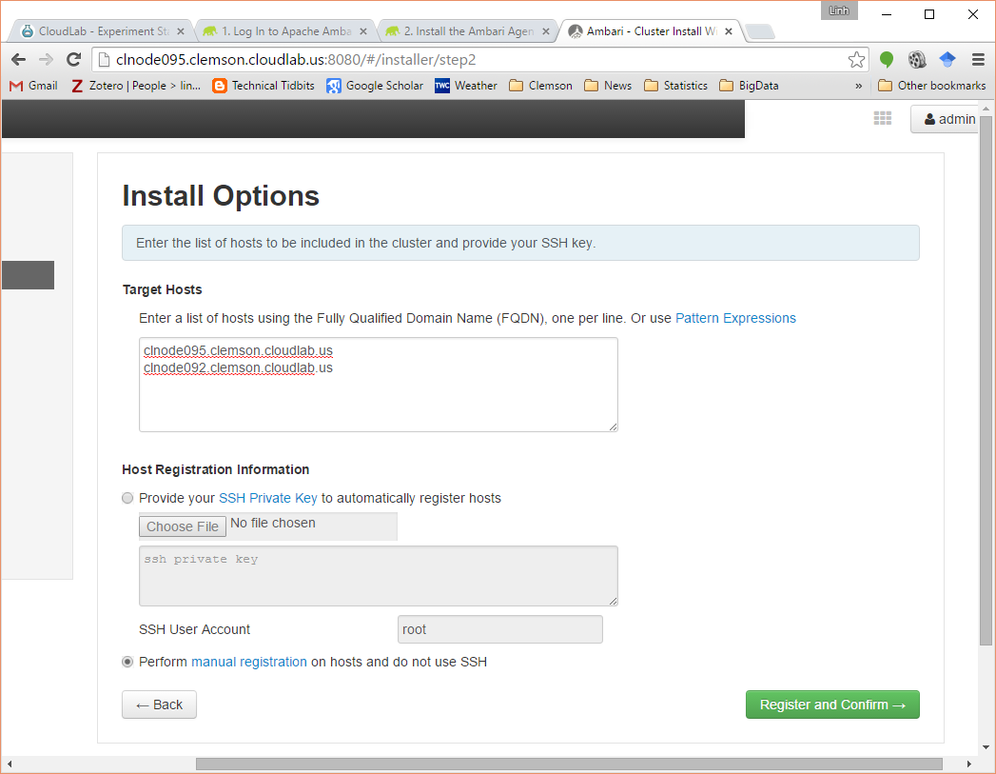
Ambari Server (admin/admin)

Slide 28
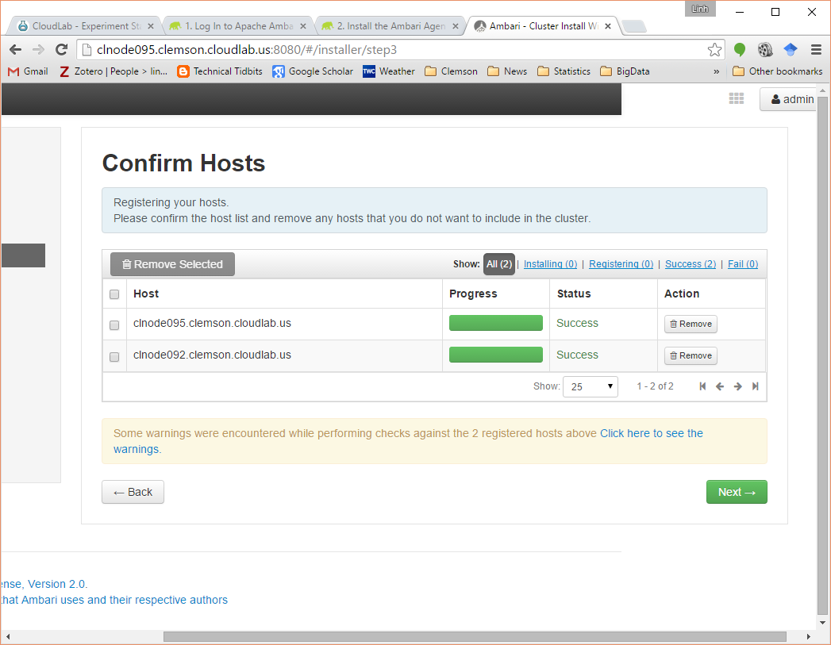
Assuming you had ambari agents up and running …

Slide 29
Ambari Server (admin/admin)
HDFS
YARN+MapReduce2
Tez
ZooKeeper
Ambari Metrics

Slide 30
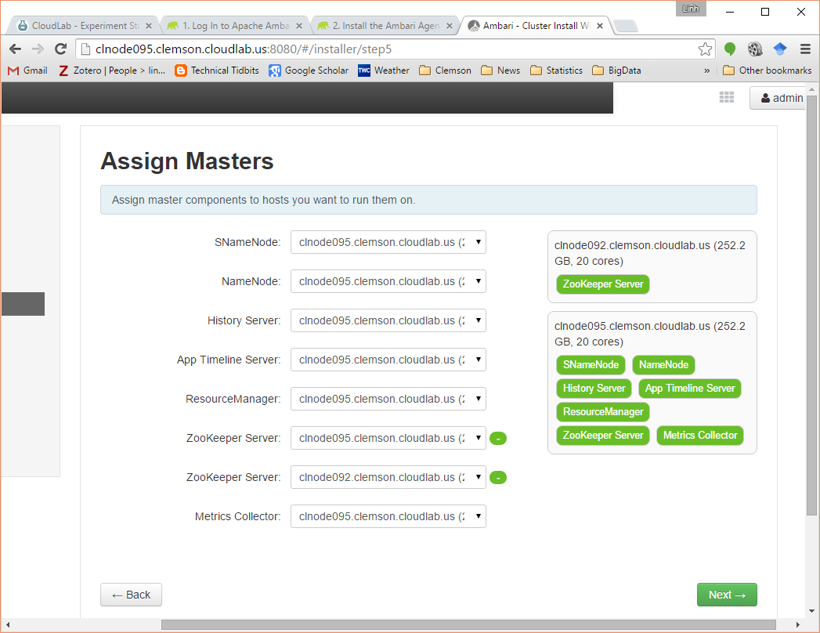
Ambari Server (admin/admin)

Slide 31
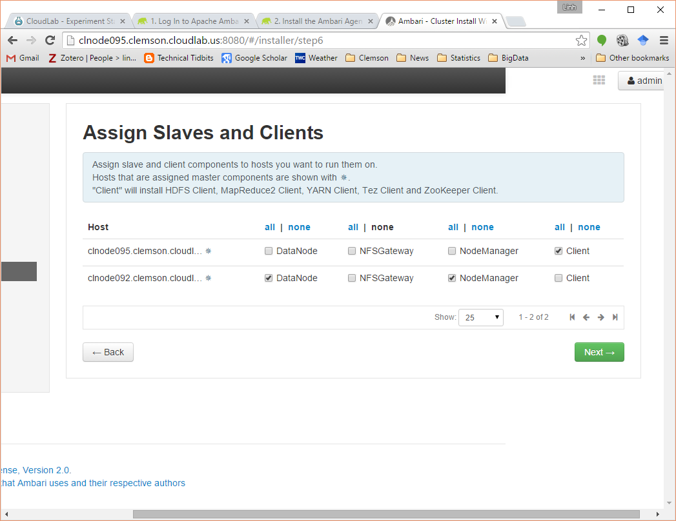
Ambari Server (admin/admin)

Slide 32
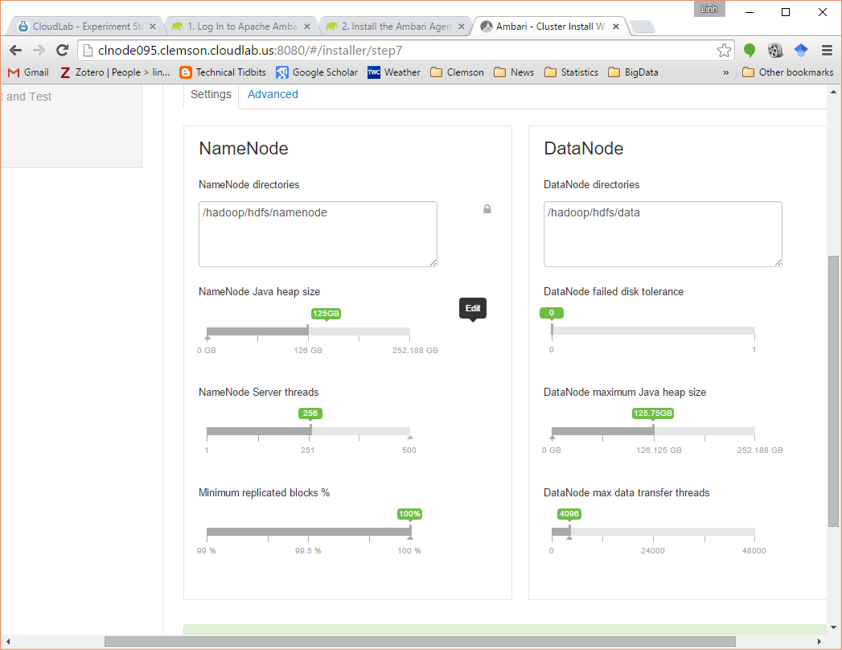
Edit configuration as you see fit

Slide 33
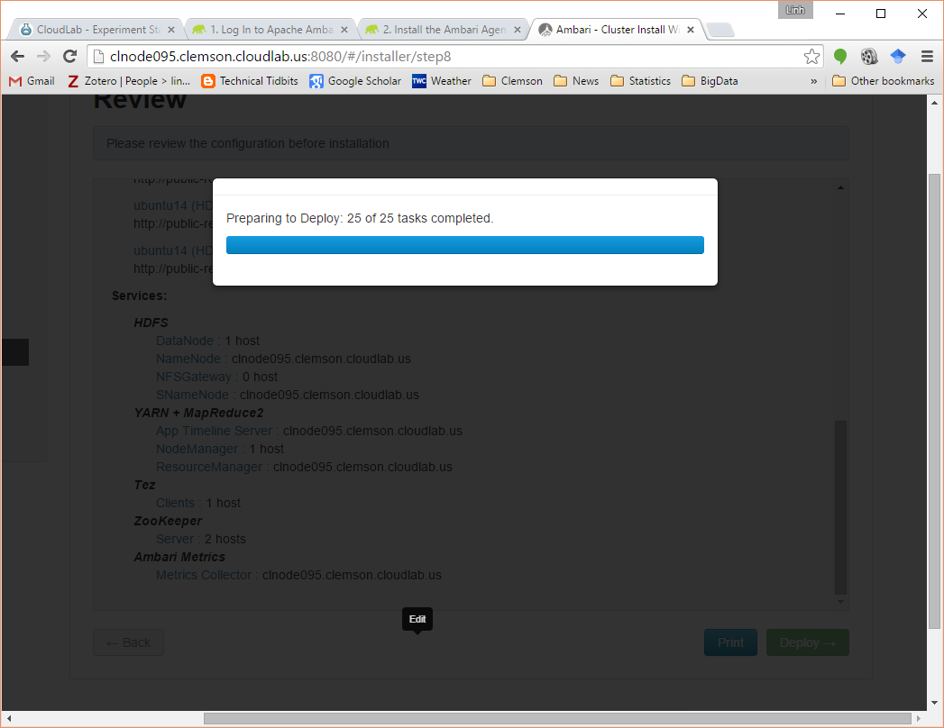
Deploy …

Slide 34
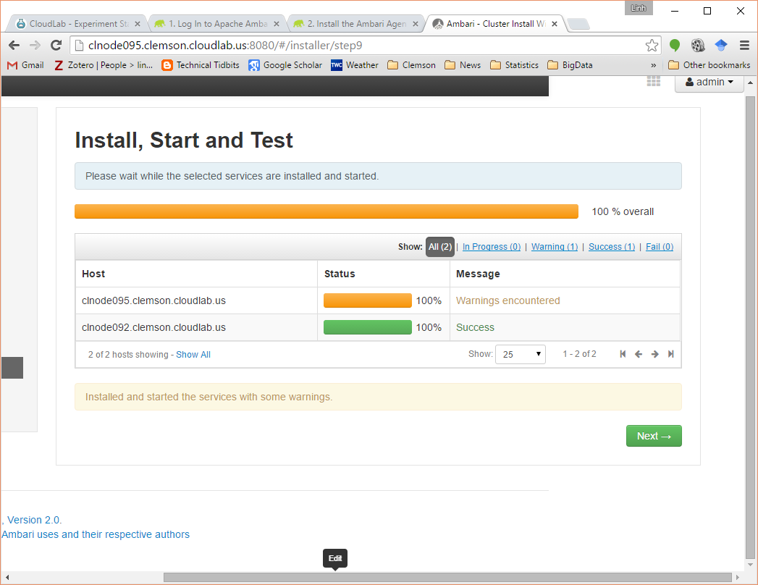
Warning due to lack of space and failed checks (ignore)

Slide 35
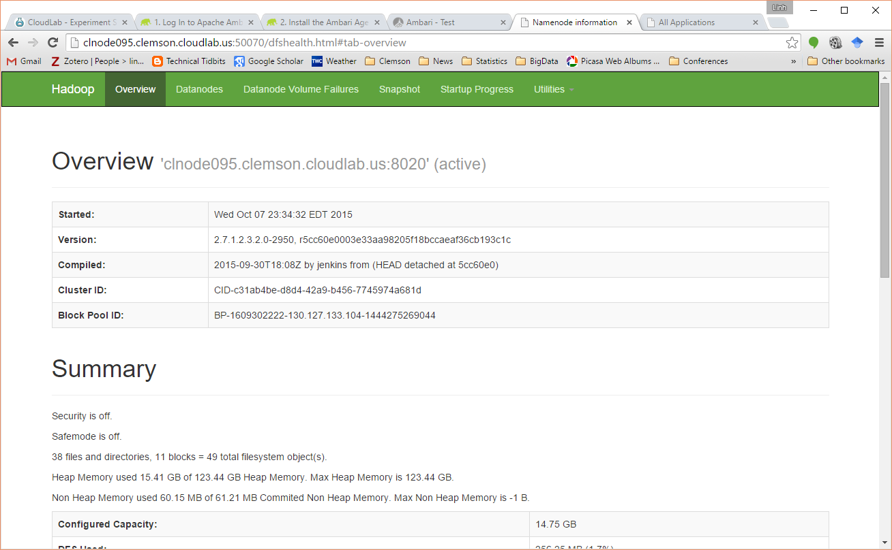
HDFS

Slide 36
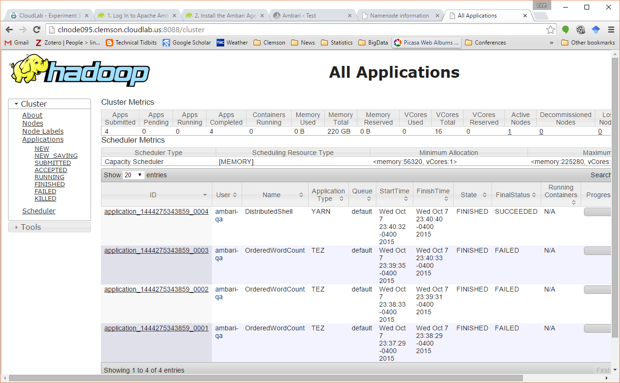
YARN

Slide 37
Tutorial
sudo su hdfs
hdfs dfs –mkdir /user/<username>
hdfs dfs –chown <username>:<username> /user/<username>
exit to <username>
hdfs dfs –ls /user/
git clone https://github.com/clemsoncoe/Introduction-to-Hadoop-data.git
cd Introduction-to-Hadoop-data
hdfs dfs –put gutenberg-shakespeare.txt /user/<username>/
yarn jar /usr/hdp/current/hadoop-mapreduce-client/hadoop-mapreduce-examples-2.7.1.2.3.6.0-3796.jar wordcount gutenberg-Shakespeare.txt output/
hdfs dfs –ls output
hdfs dfs –cat output/part-r-00000

Slide 38
Assignment Ideas
Deploy a Hadoop cluster and upload a large data set (Airline on-time performance data: http://stat-computing.org/dataexpo/2009/the-data.html)
Examine and investigate performance of Hadoop MapReduce as data nodes are killed/added to the cluster
Examine performance of Hadoop MapReduce as data nodes are located on different sites

