Slide 1




Slide 2
Today’s Plan
Everyone will build their own clouds
  Using an OpenStack profile supplied by CloudLab
  Each is independent, with it’s own compute and storage resources
Log in using GENI accounts
Create a cloud
Explore the CloudLab interface
Use your cloud
Administer your cloud
CloudLab is about more than OpenStack

Slide 3
Prerequisites
Account on the GENI portal (sent to you as “pre work”)
Optional, but will make your experience better:
  SSH keypair associated with your GENI portal account
  Knowledge of how to use the private SSH key from your laptop
Known to work best in Chrome and Firefox browsers
Tablets might work, but not well tested

Slide 4
Notes:
It’s important to realize that CloudLab is not a cloud
It’s a facility for building clouds of your own – a place where you can take the pieces that would a given in a cloud that you might use – the network, the virtualization layer, the storage system, and instead of taking what someone else gives you, build them and experiment with them yourself

Slide 5
Crash Course in CloudLab
Underneath, it’s GENI
  Same APIs, same account system
  Even many of the same tools
  Federated (accept each other’s accounts, hardware)
Physical isolation for compute, storage (shared net.*)
Profiles are one of the key abstractions
  Defines an environment – hardware (RSpec) / software (images)
  Each “instance” of a profile is a separate
  Provide standard environments, and a way of sharing
  Explicit role for domain experts
“Instantiate” a profile to make an “Experiment”
  Lives in a GENI slice
* Can be dedicated in some cases

Slide 6
What Is CloudLab?
Slice A
Geo-Distributed Storage Research
Slice B
Stock
OpenStack
Supports transformative cloud research
Built on Emulab and GENI
Control to the bare metal
Diverse, distributed resources
Repeatable and scientific
Slice C
Virtualization and Isolation Research
Slice D
Allocation and Scheduling Research for Cyber-Physical Systems
Utah
Wisconsin
Clemson
GENI
CC-NIE, Internet2 AL2S, Regionals

Slide 7
CloudLab’s Hardware
One facility, one account, three locations
About 5,000 cores each (15,000 total)
8-16 cores per node
Baseline: 8GB RAM / core
Latest virtualization hardware
TOR / Core switching design
10 Gb to nodes, SDN
100 Gb to Internet2 AL2S
Partnerships with multiple vendors
Wisconsin
Clemson
Utah
Storage and net.
Per node:
  128 GB RAM
  2x1TB Disk
  400 GB SSD
Clos topology
Cisco
High-memory
16 GB RAM / core
16 cores / node
Bulk block store
Net. up to 40Gb
High capacity
Dell
Power-efficient
ARM64 / x86
Power monitors
Flash on ARMs
Disk on x86
Very dense
HP

Slide 8
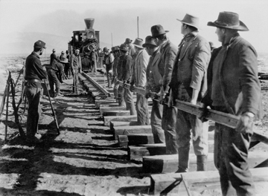

Slide 9
cloudlab.us/tutorial

Slide 10
CloudLab Hardware

Slide 11
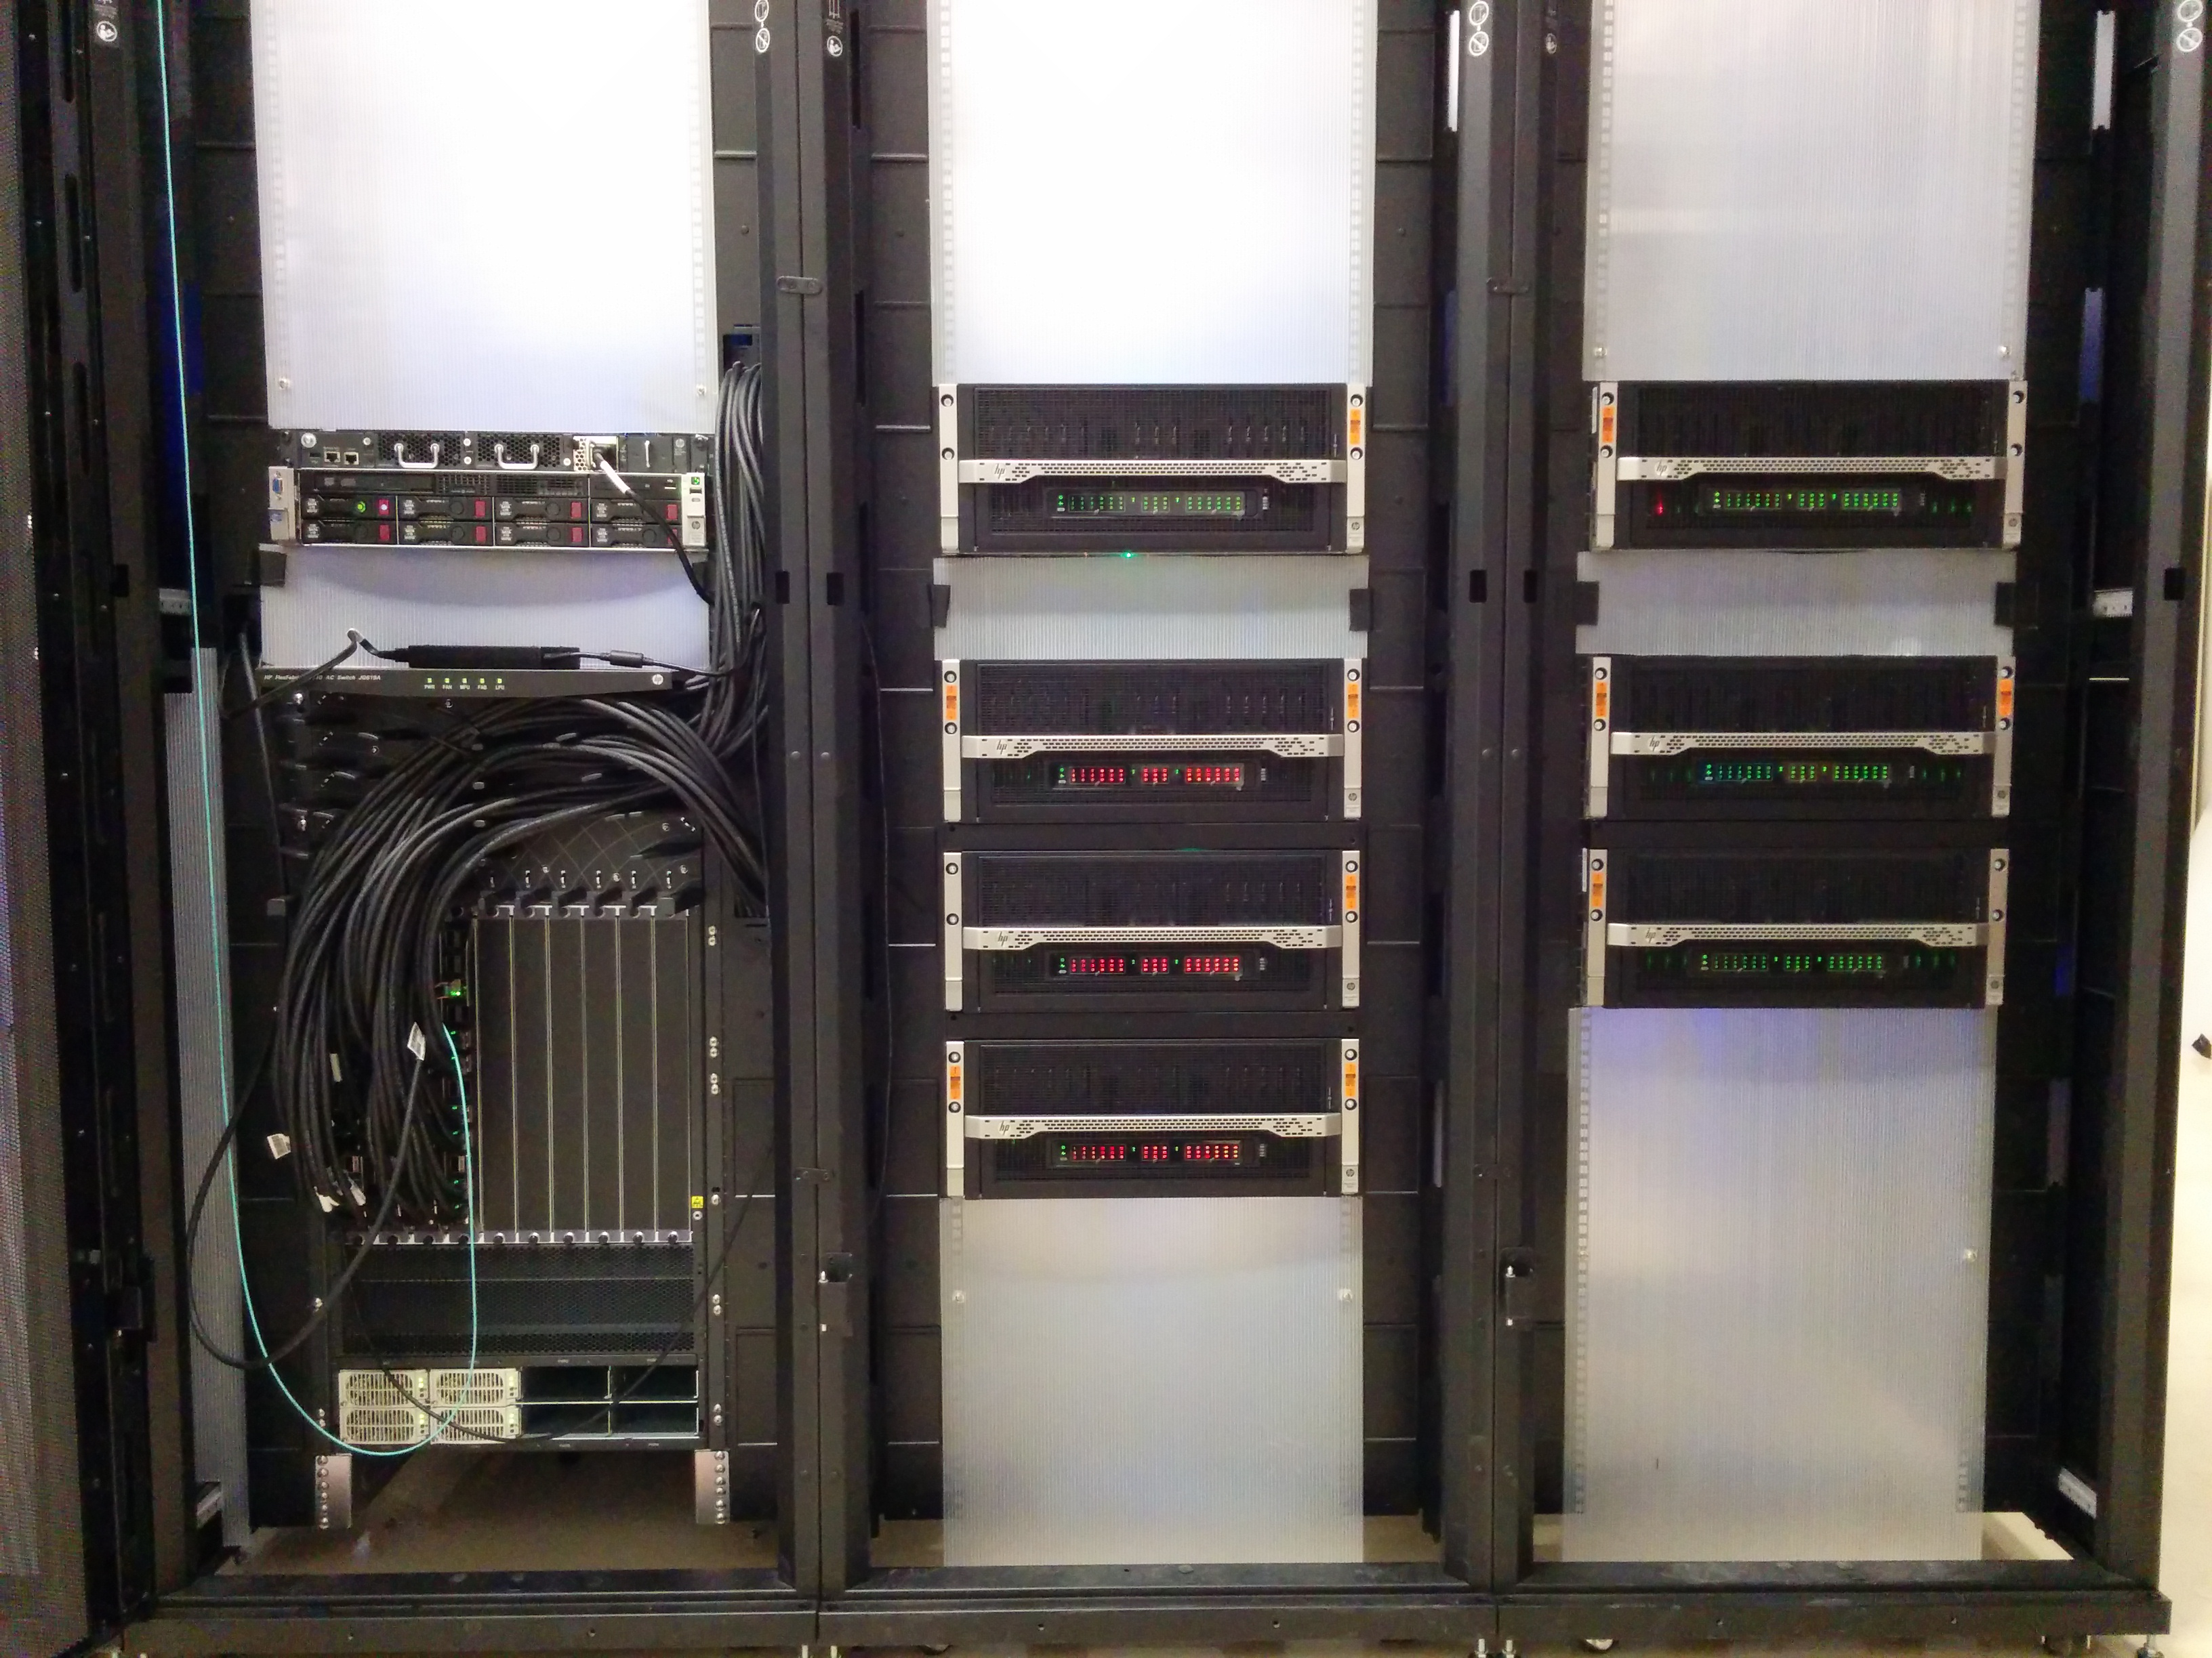
Utah/HP: Very dense

Slide 12

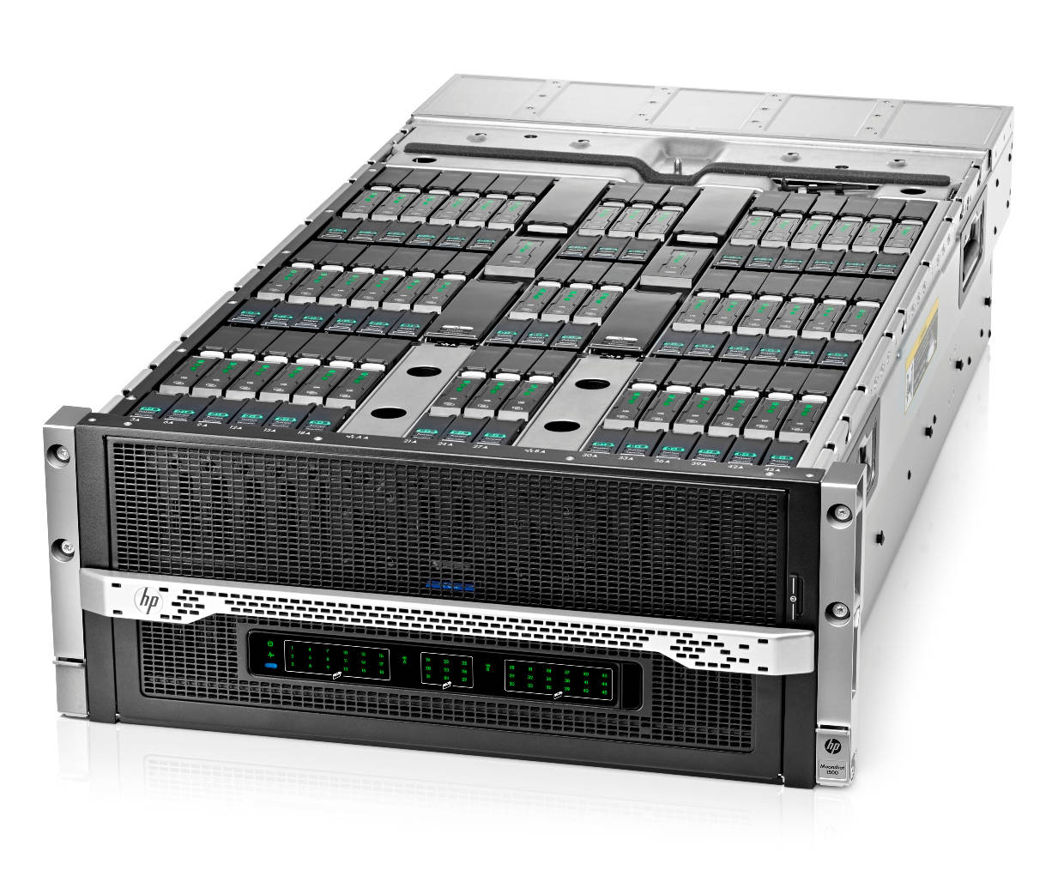
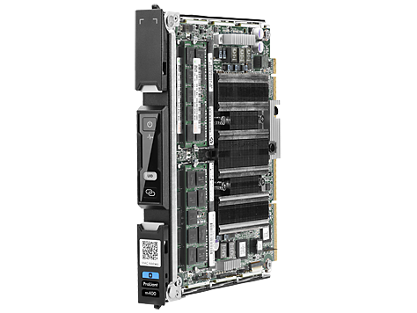
Utah/HP: Low-power ARM64
2 switches
1.3
315 nodes
2,520 cores
8.5 Tbps
8 cores
120 GB Flash
45 cartridges
64 GB RAM

Slide 13
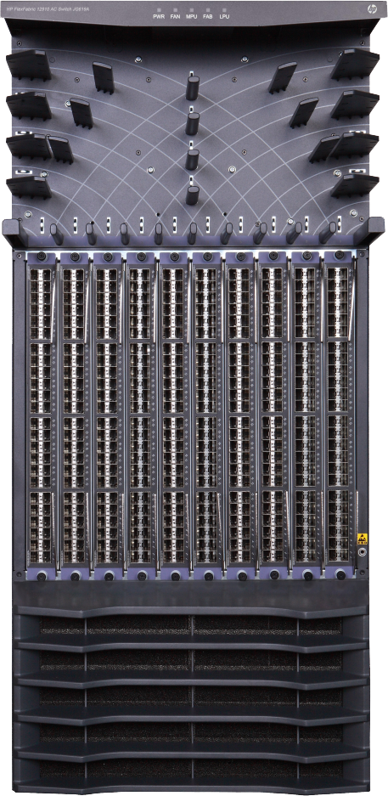
Utah/HP Network: Core switch
4x 40 Gb
2x 10 Gb
320 Gb uplink
x7

Slide 14
Utah - Suitable for experiments that:
… explore power/performance tradeoffs
… want instrumentation of power and temperature
… want large numbers of nodes and cores
… want to experiment with RDMA via RoCE
… need bare-metal control over switches
… need OpenFlow 1.3
… want tight ARM64 platform integration

Slide 15
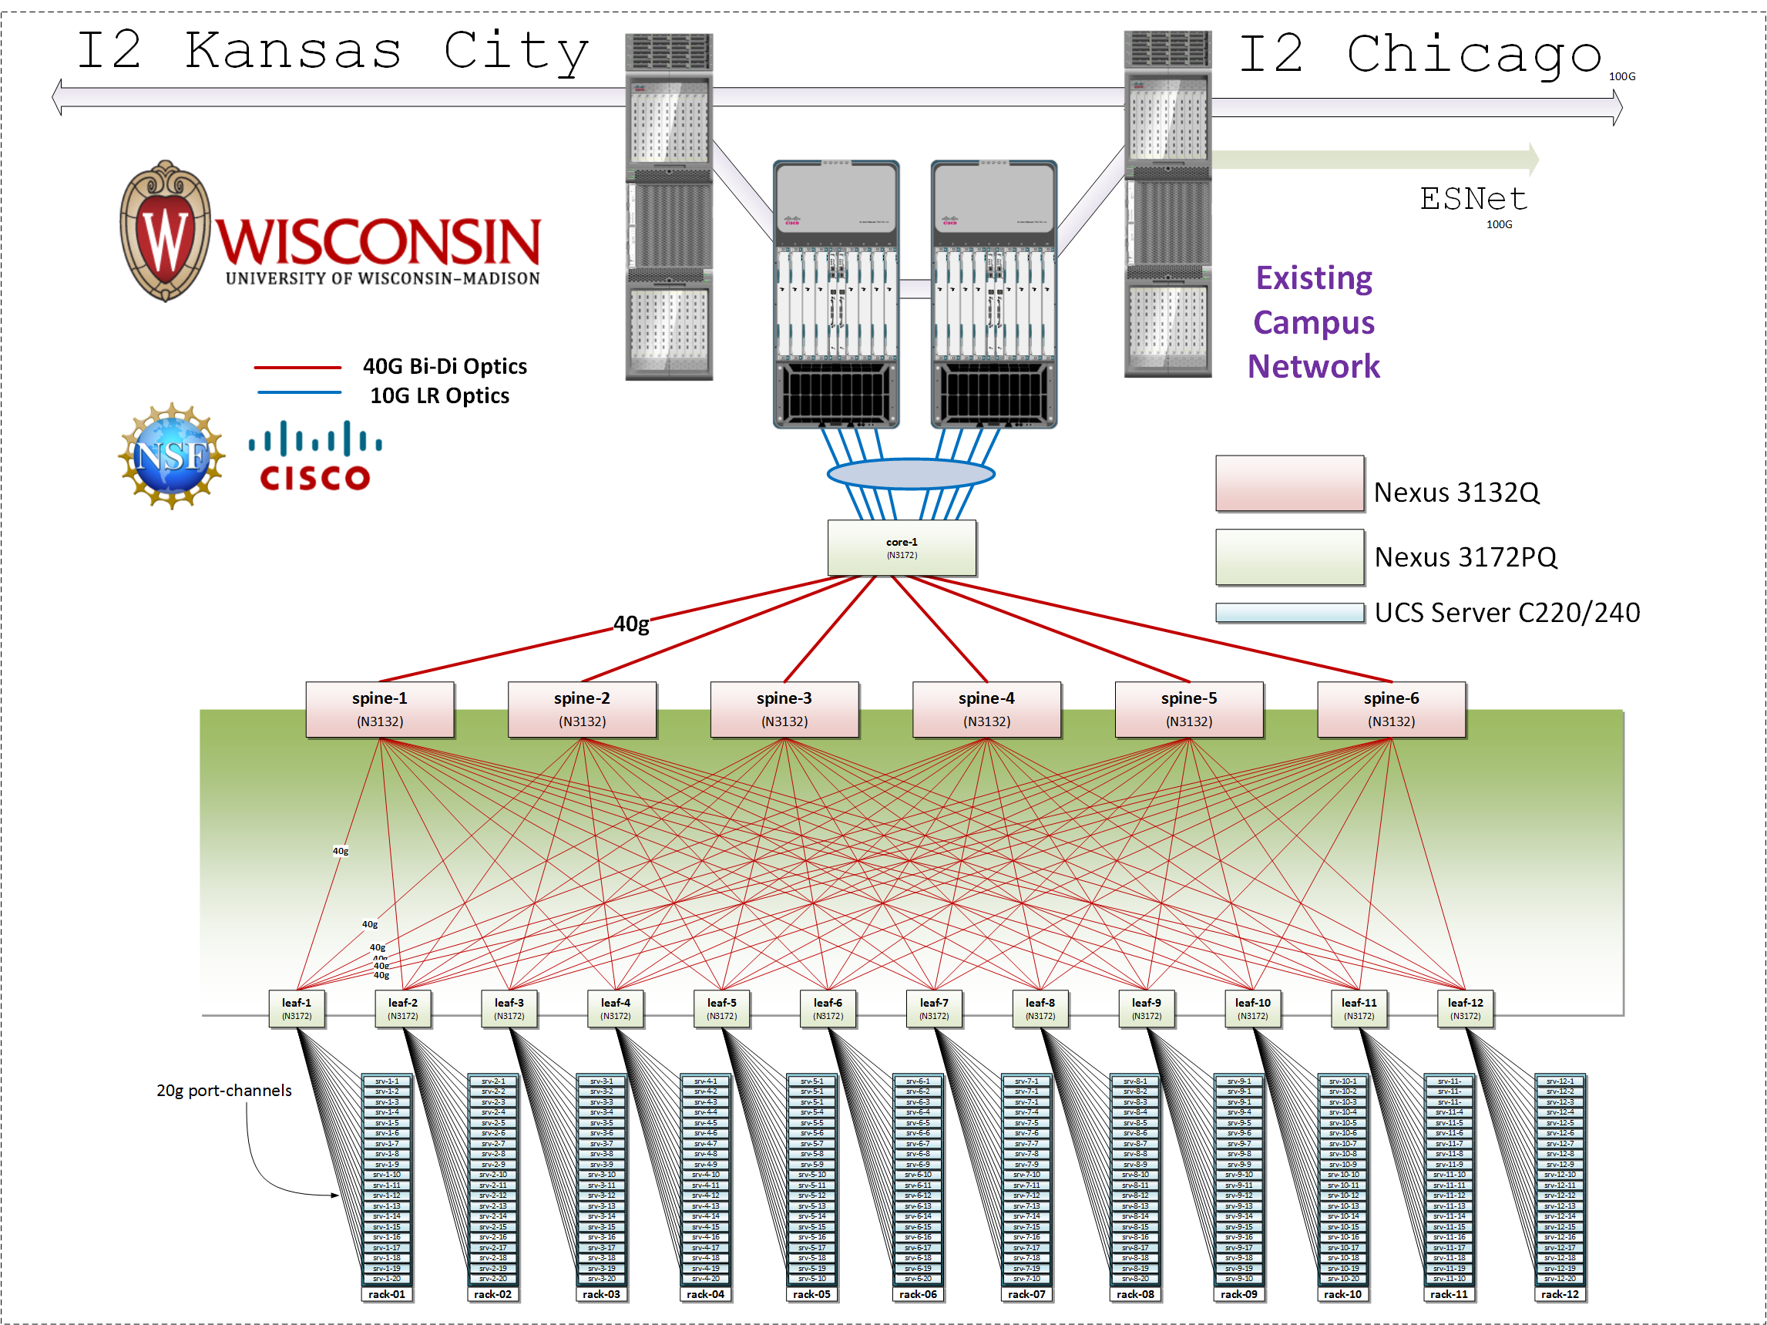
Wisconsin/Cisco
Nexus 3172PQ
8X10G
40G
Nexus 3132Q
40G
Nexus 3172PQ
2X10G
20X12
servers

Slide 16
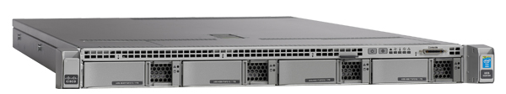
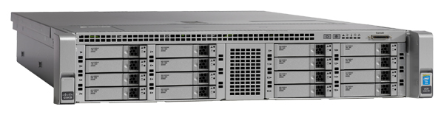
Compute and storage
90X Cisco 220 M4
10X Cisco 240 M4
2X 1.2 TB HDD
2X 8 cores @ 2.4GHz
128GB RAM
1X 480GB SSD
1X 1TB HDD
12X 3TB HDD
(donated by Seagate)
Over the next year: ≥ 140 additional servers;
Limited number of accelerators, e.g., FPGAs, GPUs (planned)

Slide 17
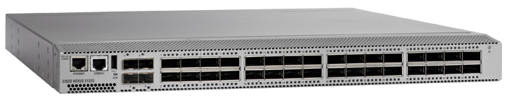
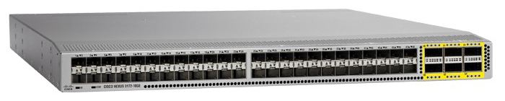
Networking
Nexus 3132q
Nexus 3172pq
OF 1.0 (working with Cisco on OF 1.3 support)
Monitoring of instantaneous queue lengths
Fine-grained tracing of control plane actions
Support for multiple virtual router instances per router
Support for many routing protocols

Slide 18
Experiments supported
Large number of nodes/cores, and bare-metal control over nodes/switches, for sophisticated network/memory/storage research
… Network I/O performance, intra-cloud routing (e.g., Conga) and transport (e.g., DCTCP)
… Network virtualization (e.g., CloudNaaS)
… In-memory big data frameworks (e.g., Spark/Shark)
… Cloud-scale resource management and scheduling (e.g., Mesos; Tetris)
… New models for Cloud storage (e.g., tiered; flat storage; IOFlow)
… New architectures (e.g., RAM Cloud for storage)

Slide 19
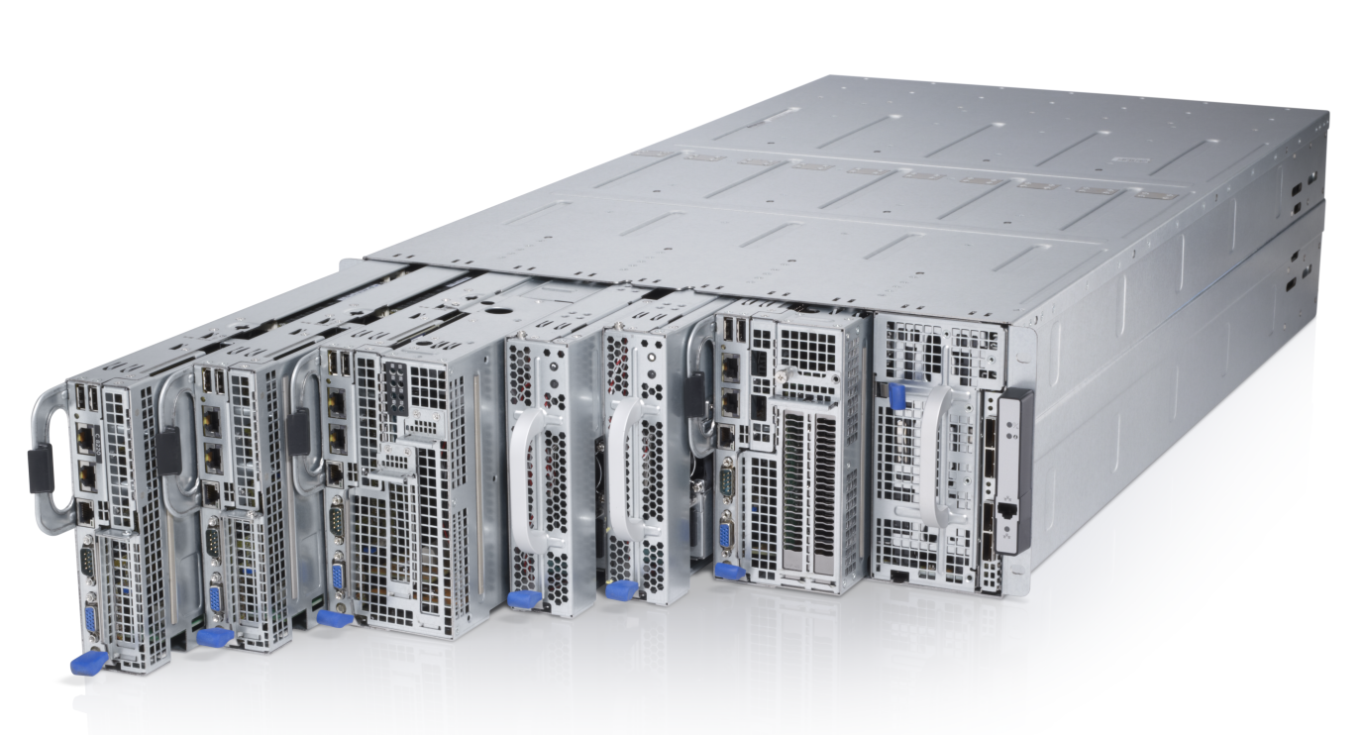
Clemson/Dell: High Memory, IB
20 cores/node
1 x 40 Gb IB/node
8 nodes/chassis
2*x 10 GbE OF/node
10 chasses/rack
2*x 1 GbE OF/node
256 GB RAM/node
2 x 1 TB drive/server
* 1 NIC in 1st build

Slide 20

Clemson/Dell Network: IB + 10 GbE
Clemson
NextNet
S6000
IB QDR
Q1 2015: 2K+ cores
Complete: ~5K cores
100 GbE
2 x 10 GbE
2 x 10 GbE
8x40 GbE
8x40 GbE
S6000
N2048
S6000
N2048
N2048
N2048
80x10GbE
80x1GbE
80x10GbE
80x1GbE
8 node chassis
8 node chassis
8 node chassis
8 node chassis
96x40GbE
10 chasses/rack
10 chasses/rack
8 node chassis
8 node chassis

Slide 21
Clemson - Suitable for experiments that:
… need large per-core memory
  e.g., High-res media processing
  e.g. Hadoop
  e.g., Network Function Virtualization
… want to experiment with IB and/or GbE networks
  e.g., hybrid HPC with MPI and TCP/IP
  e.g., cyber physical system
… need bare-metal control over switches
… need OpenFlow 1.3

Slide 22
Building Profiles

Slide 23
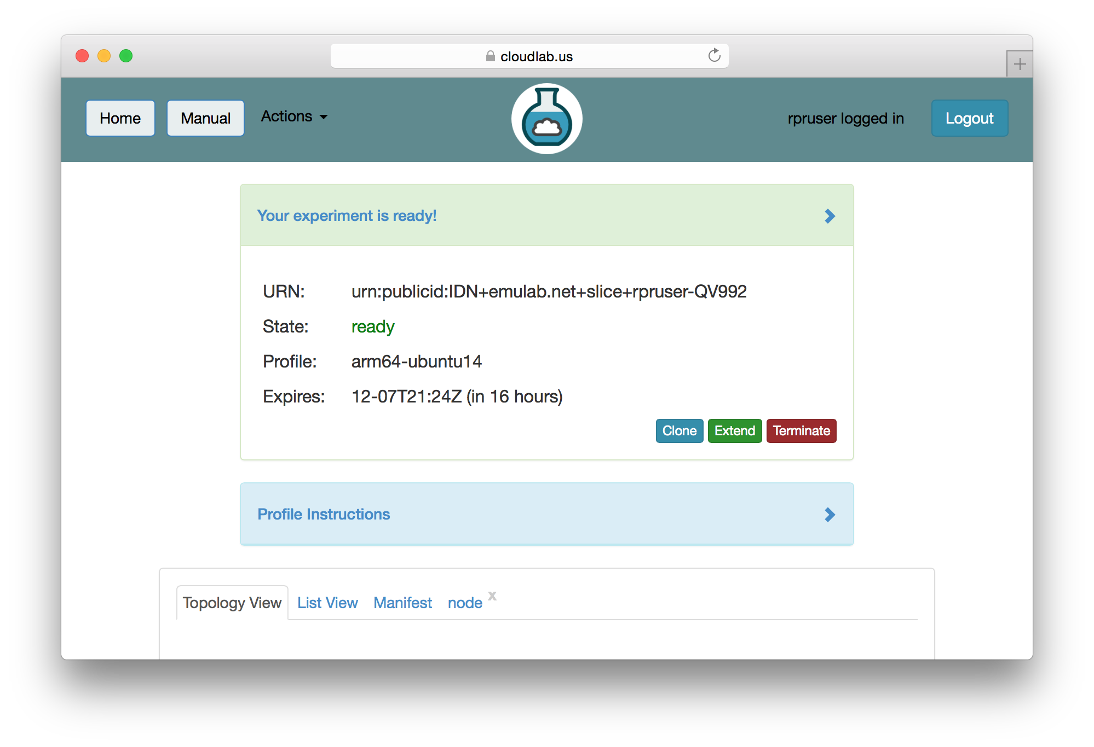
Copy an Existing Profile

Slide 24
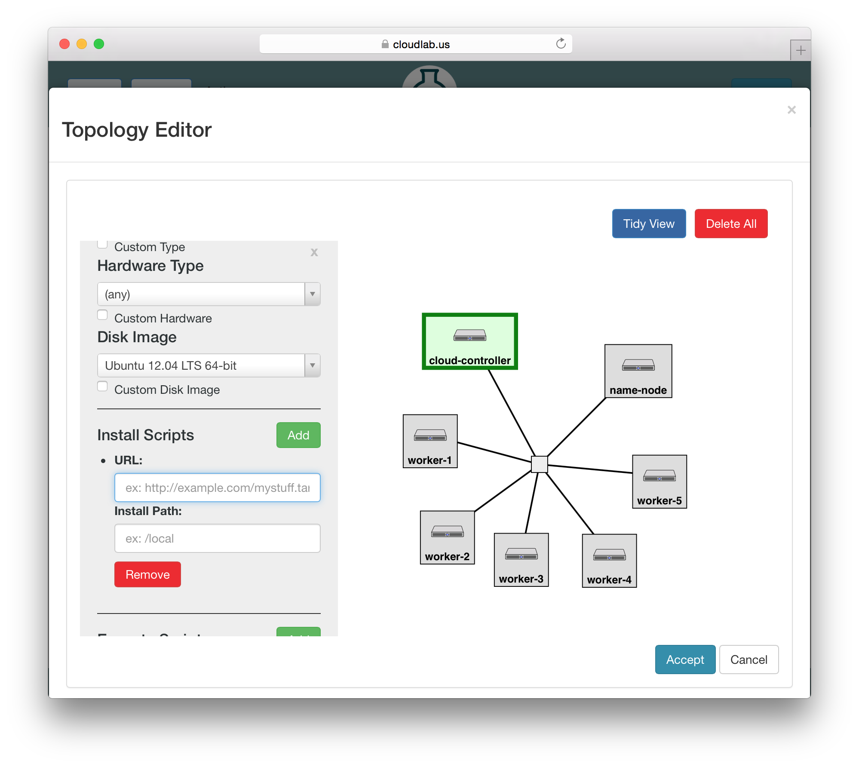
Use a GUI (Jacks)

Slide 25
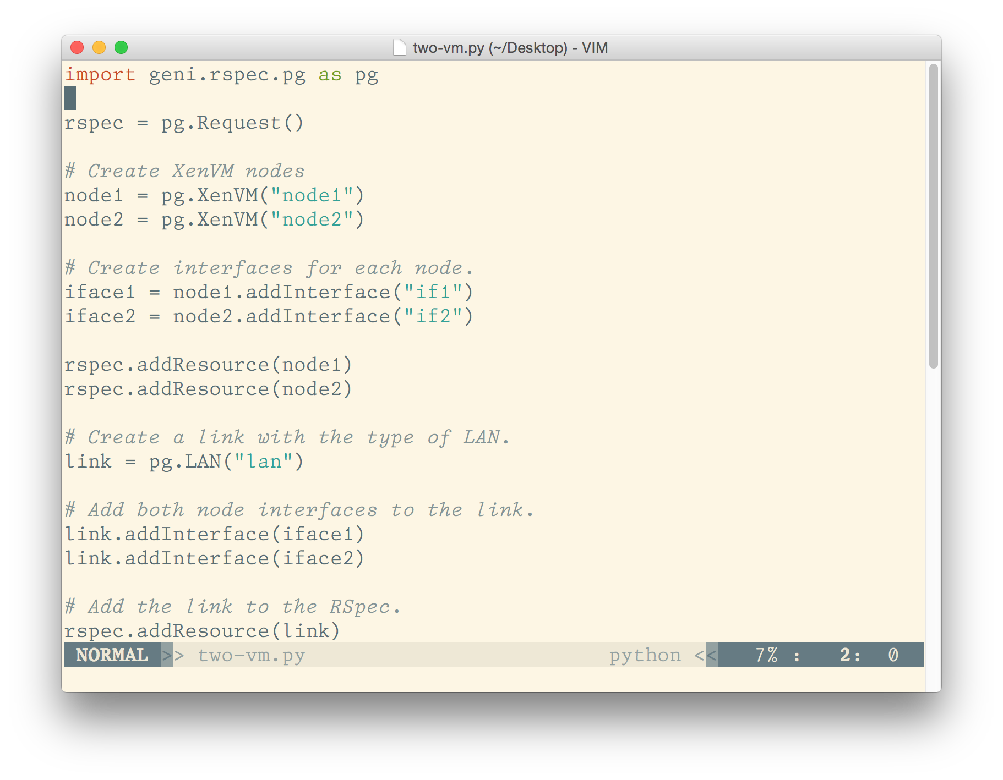
Write Python Code (geni-lib)

Slide 26
GENI-LIB
http://geni-lib.readthedocs.org/
or
http://geni-lib.readthedocs.io/en/latest/

Slide 27
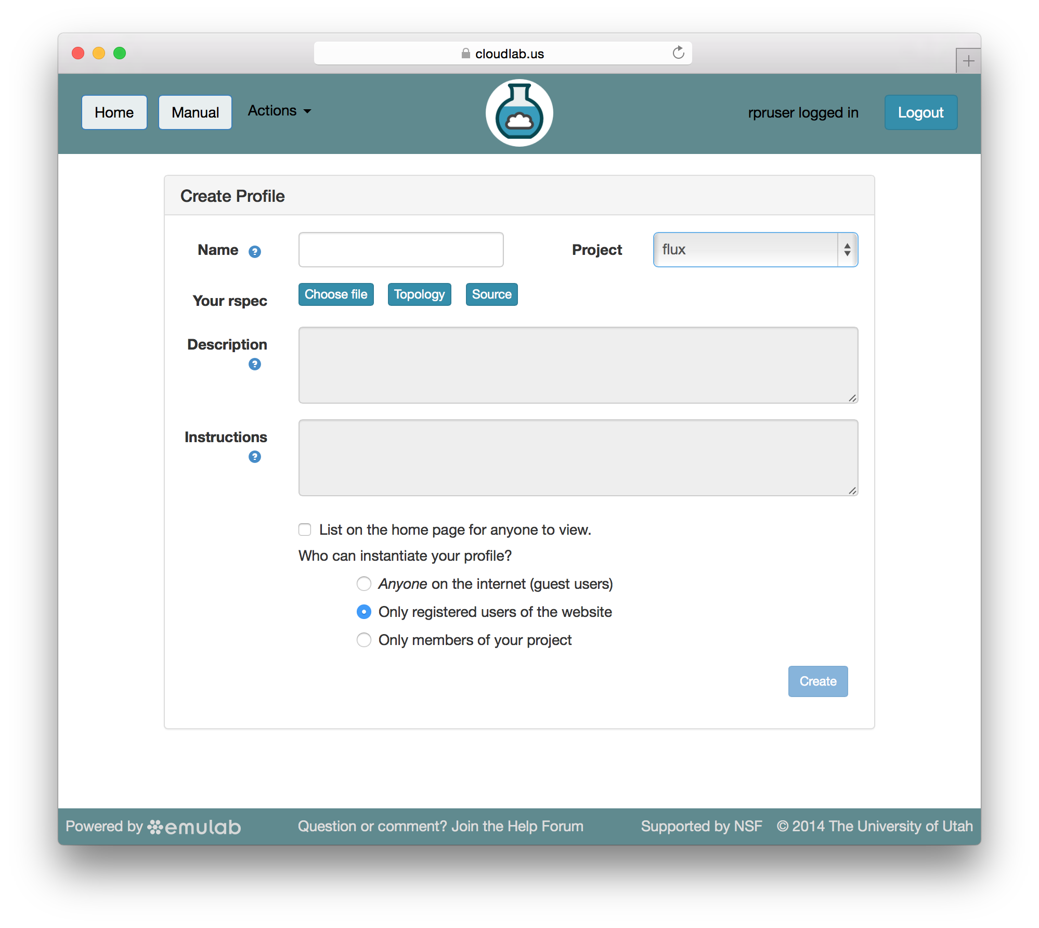
Build From Scratch

Slide 28
Sign Up

Slide 29
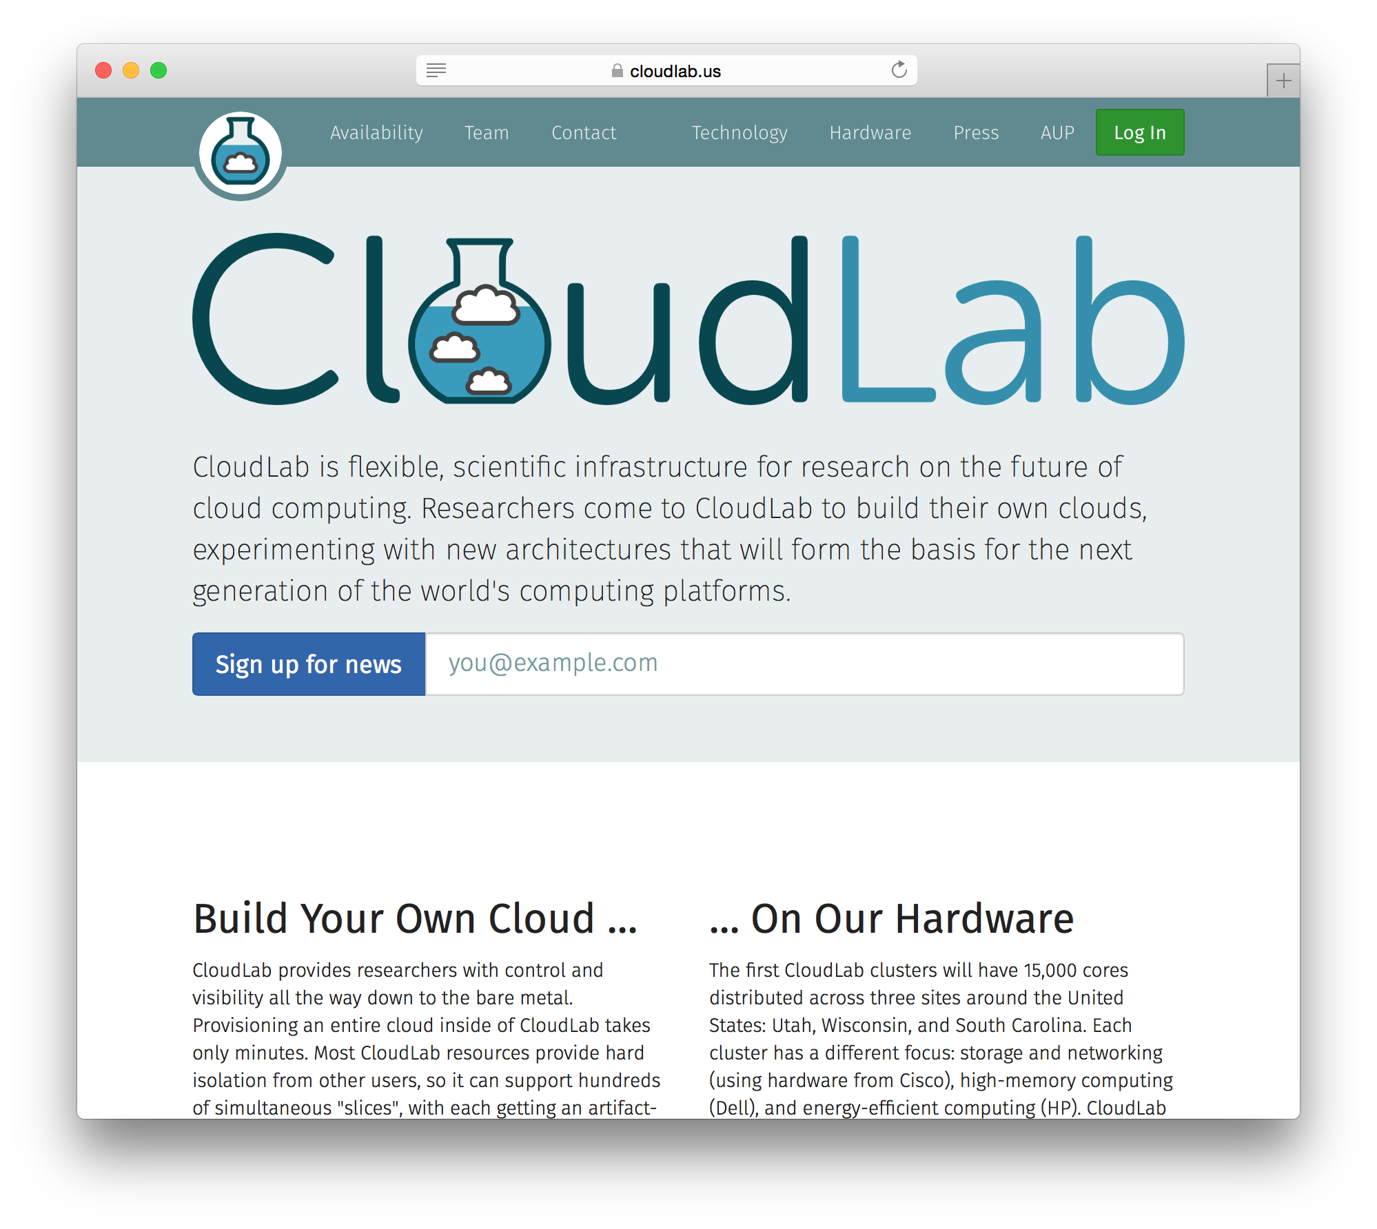
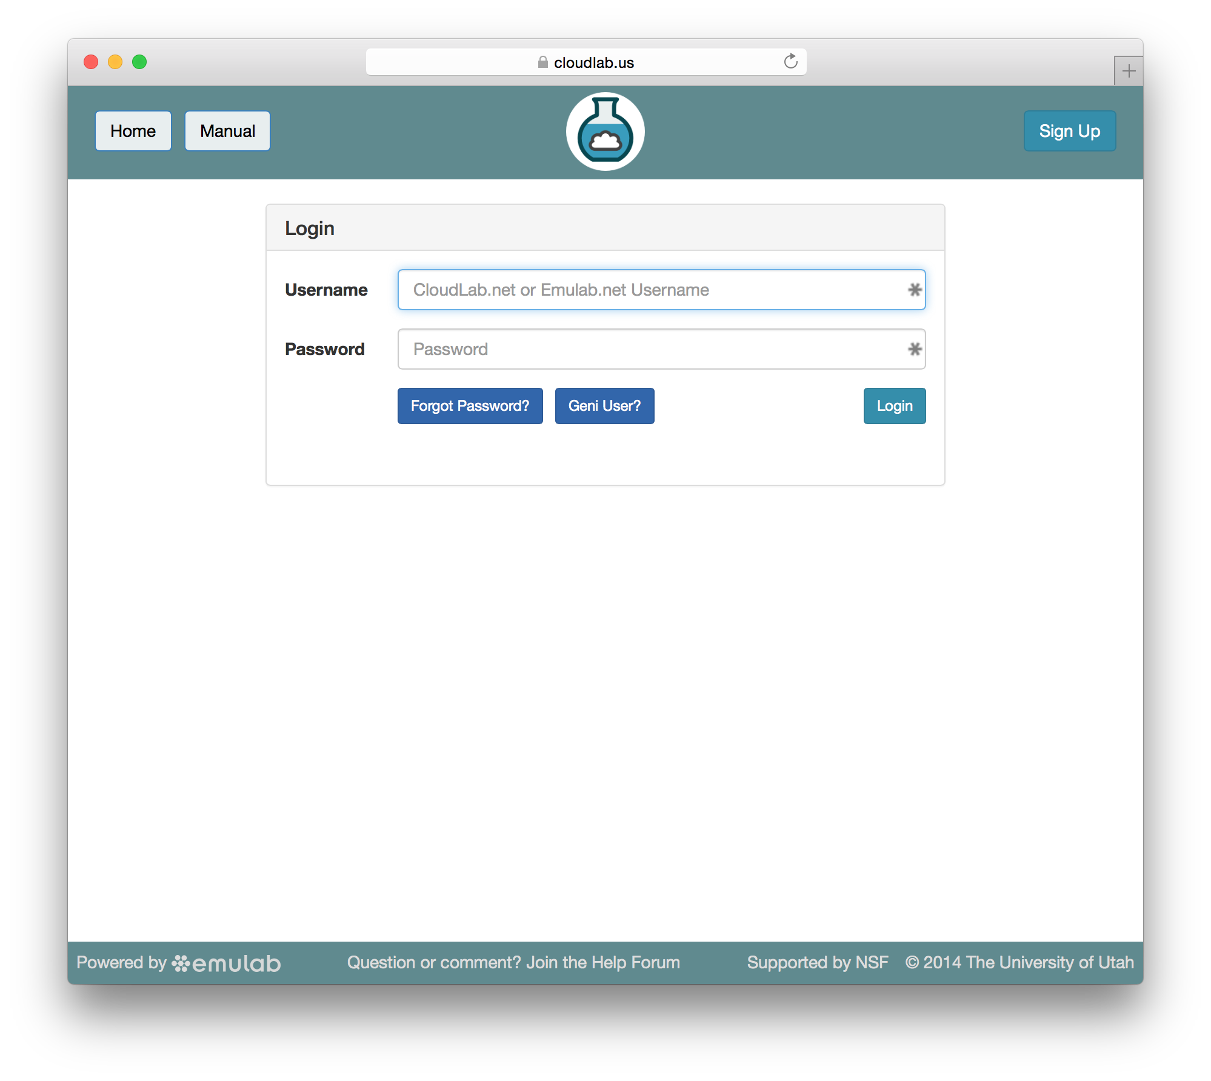
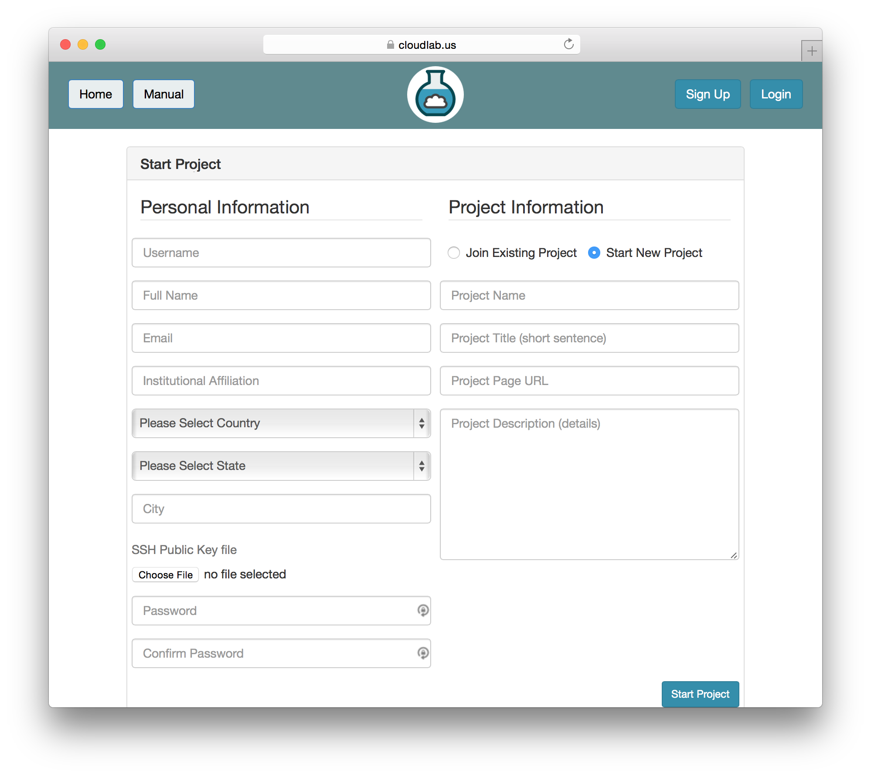
Sign Up At CloudLab.us

